Slide 1
"Segurança e Proteção Radiológica em Centrais Nucleares"
Palestrante: Eng Marcos Antonio Do Amaral
Horário: 19h00 – 21h30

Slide 2
Riscos e percepção de riscos relativos a uma central nuclear
Créditos: Dr. Abel González – IAEA / UNSCEAR / ARN

Slide 3
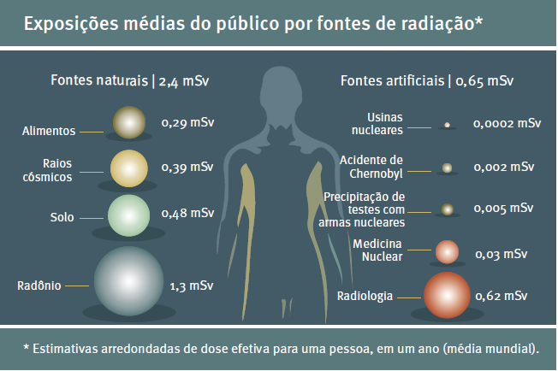

Slide 4

modelagem matemática do ambiente
Dose coletiva
descarga de efluentes

Slide 7
Conjecturas
subjetivas
Fatos objetivos

Slide 8
Inferência
(opinião)
Atribuição
coletiva
(epidemiológica)
Atribuição
individual
(diagnóstico)
Conjecturas
subjetivas
Fatos objetivos

Slide 9
Carvão é dominante
A maior parte da radiação incorridos pela humanidade devido à geração de eletricidade vem da combustão do carvão.
O ciclo do carbono (mineração, combustão e cinzas) contribui com mais de 50% da exposição global à radiação causada pela produção mundial de eletricidade.
(A estimativa assumiu centrais a carvão modernas, caso contrário, o saldo teria sido ainda mais desfavorável)

Slide 10
A contribuição do ciclo nuclear é menor do que o carvão
O ciclo do combustível nuclear contribui com menos de 20%.
Não vem a partir da operação de NPP, mas a mineração de urânio.

Slide 11
Tecnologia utilizada para a geração de eletricidade | Dose coletiva normalizada devido à extração e processamento de minerais necessários à construção de plantas e geradores de energia elétrica [pessoa sievert/GWano]
Solar | 0,8
Vento | 0,1
Nuclear | 0,02
Carvão | 0,01
Gás Natural | 0,01
Biomassa | 0,01

Slide 12
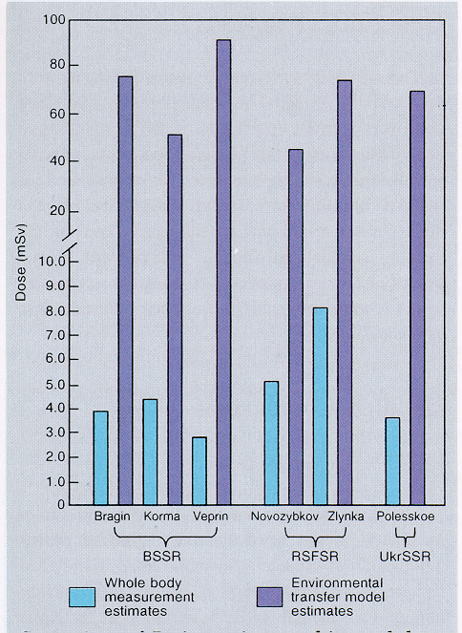
As doses de radiação avaliadas por medidas in vivo foram muito menores do que as estimativas teóricas usando modelos

Slide 13
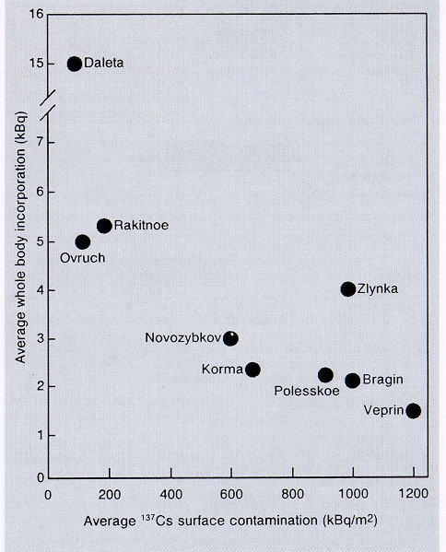
A contaminação elevada não é necessariamente igual a altas doses!

Slide 14
Admitido nos hospitais: 237
Diagnosticado com "doença de radiação aguda”: 134
Mortes: 28

Slide 15
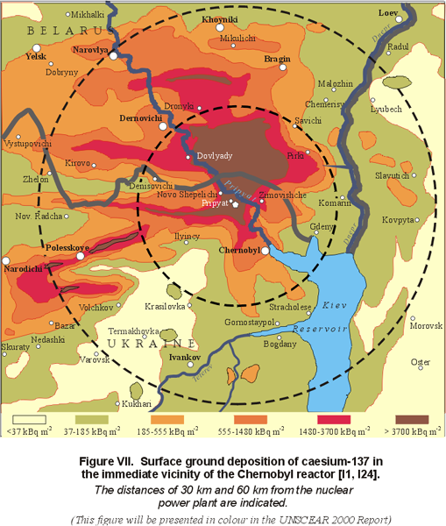
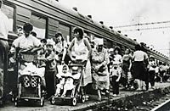
RELOCAÇÃO
Ucrania 91,406
Belarus 24,725
Russian Federation 186
Total 116,317

Slide 16
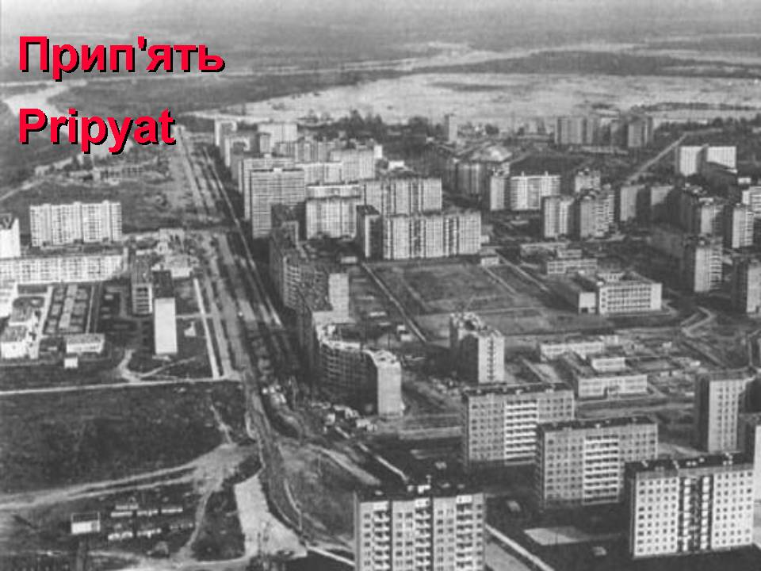

Slide 17
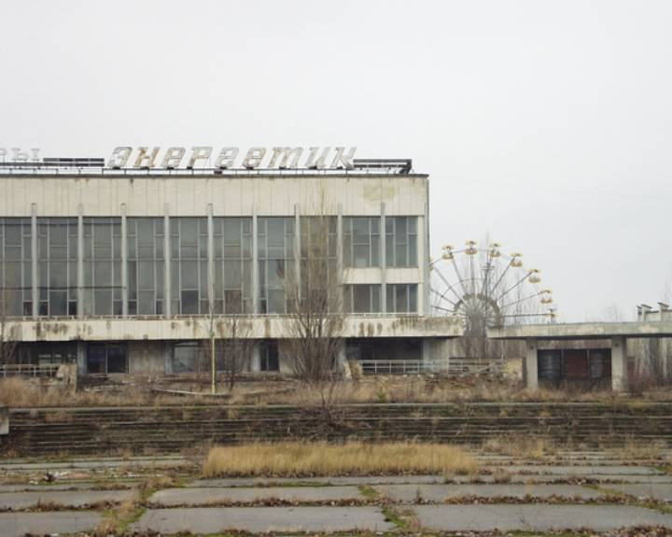

Slide 18
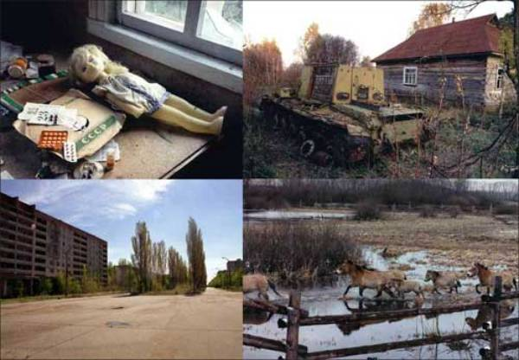

Slide 19
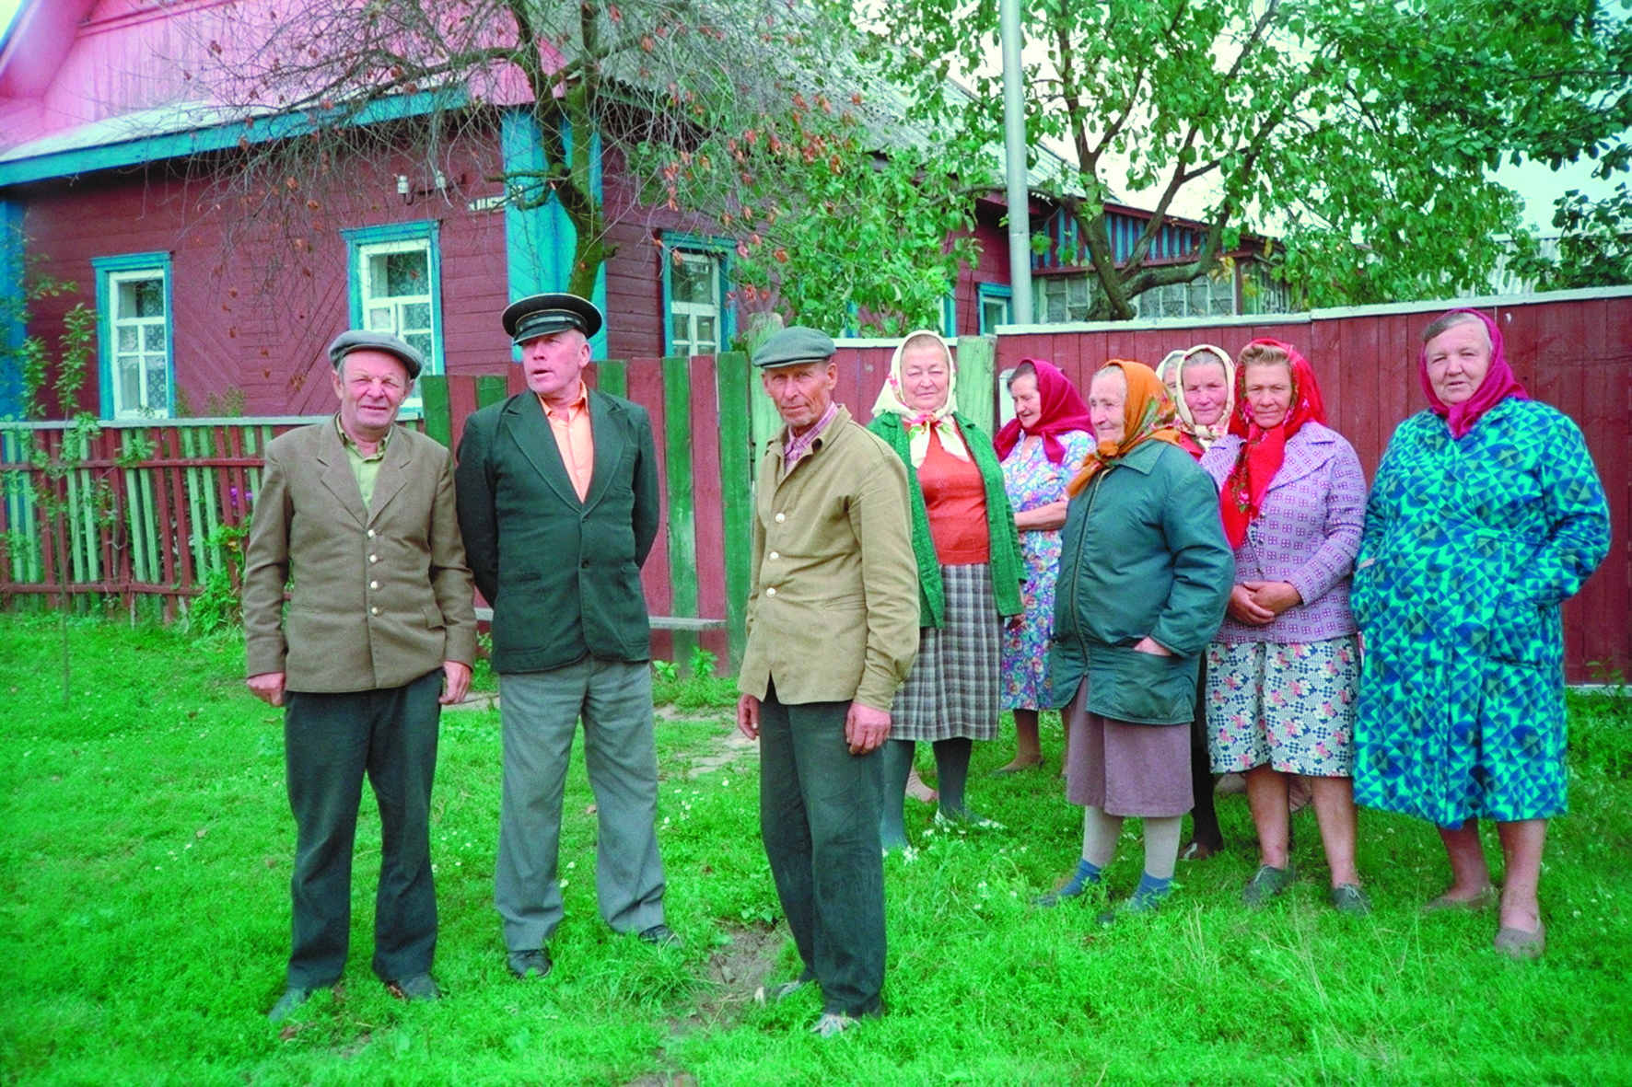
RESIDENTES NAS ÁREAS "CONTAMINADAS"

Slide 20
DOSE DOS RESIDENTES
Média (10 anos) → 8 mSv
Para sempre → 13 mSv

Slide 21
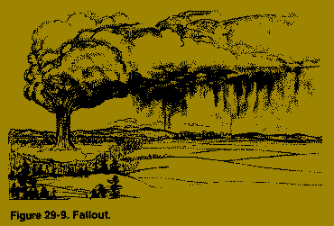
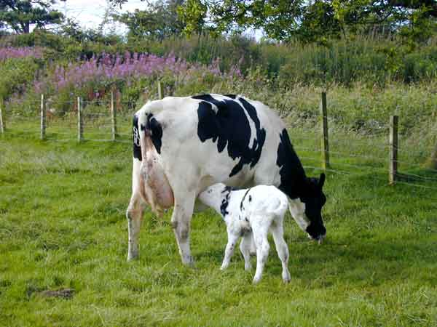


Slide 22
Dosagem na tireoide
?
Dose média na tireoideia → 300 mSv ?
Meninos mais expostos → 10000 mSv ?,
o mais?

Slide 23
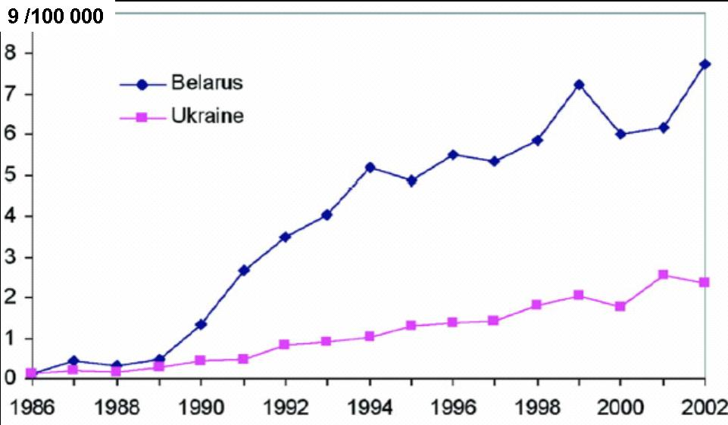
Jacob P, Bogdanova TI, Buglova E, Chepurniy M, Demidchik Y, Gavrilin Y, Kenigsberg J, Meckbach R, Schotola C, Shinkarev S, Tronko MD, Ulanovsky A, Vavilov S, Walsh L (2006) Thyroid cancer risk in areas of and Belarus affected by the Chernobyl accident. Radiat Res. 165(1) 1-8

Slide 24
En suma, pode ser atribuído a Chernobyl:

Slide 25
~ 30 mortes (~ instantâneas) e
~ 200 lesões deterministas severas clinicamente atribuíveis a Chernobyl

Slide 26
~ 7000 câncer de tireóide em meninos,
todos eles facilmente evitáveis

Slide 27
....mas também deve ser enfatizado que Chernobyl causou:

Slide 28
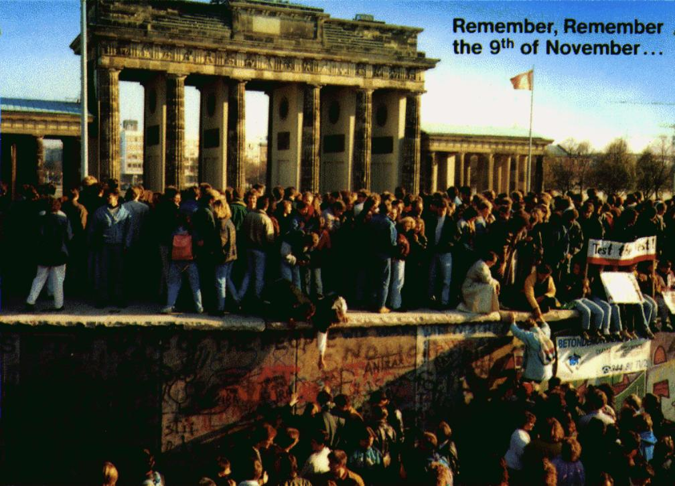
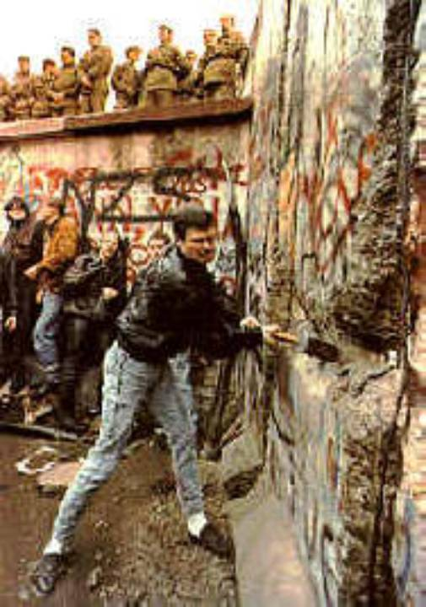
Cataclismo político

Slide 29
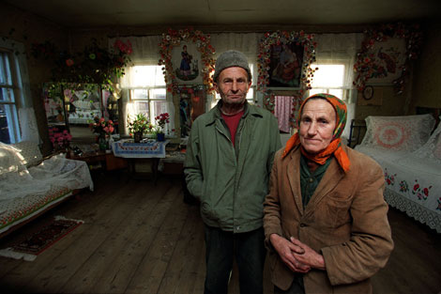
Tragédia social

Slide 30
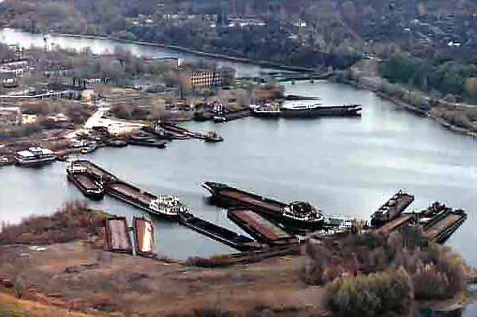
Ruína econômica

Slide 32
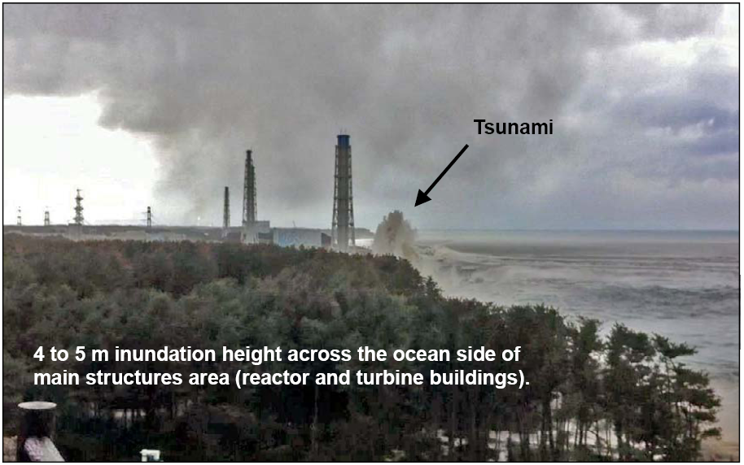
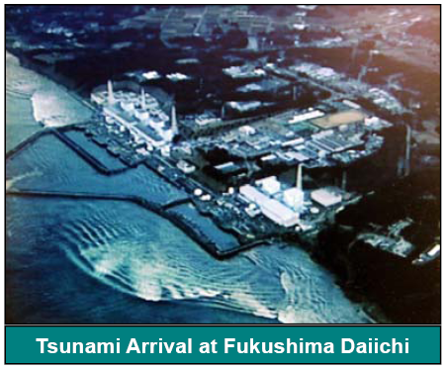
Um grande tsunami, com 14 metros de altura, inundou toda a área, matou mais de 30 mil pessoas e cancelou o resfriamento de emergência.
Nos prédios do reator e da turbina, a inundação foi maior do que 4meters
32
Notes:
₃₂

Slide 33
Apesar de todo esse cenário incrível, ninguém recebeu uma dose letal de radiação!

Slide 34
"Consequências radiológicas"
Presença de radioatividade no meio ambiente
(downloads, dispersão, depósito, produtos de consumo)
Medidas de proteção
Exposição à radiação
Efeitos
Impacto ambiental

Slide 35
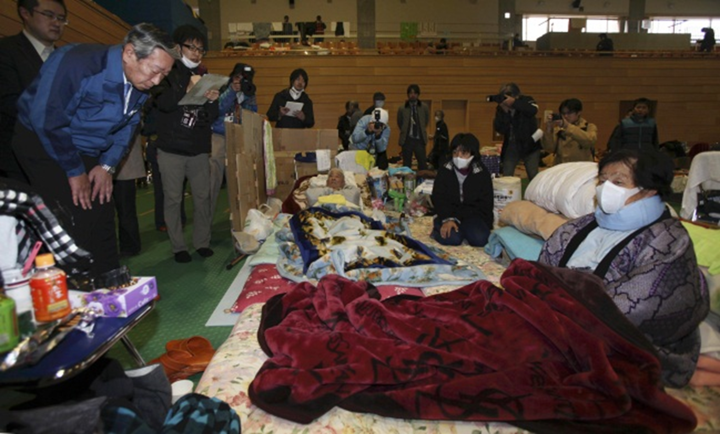
Refúgio
A evacuação inicial levou a condições superlotadas

Slide 36
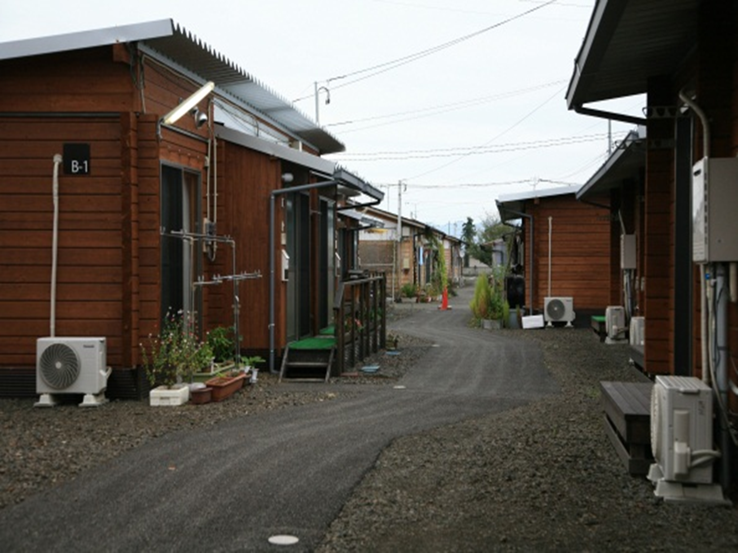
Deslocalização: as condições normais do habitat pessoal foram muito afetadas.

Slide 37
Uma questão relevante:
A justificativa de medidas de proteção disruptiva
Notes:
37

Slide 38
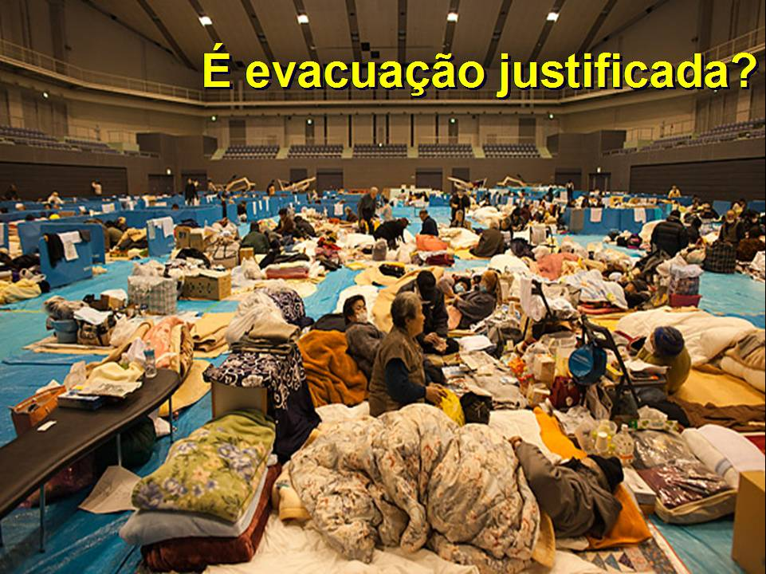

Slide 40
Perspectiva:
Fondo natural de radiación
en el mundo
Dosis anual en mSv
~100
~ 10
~ 2.4
~ 1
Pocas
poblaciones ⇒
Estimación de la
WHO
ALTA
Namie,
Itate
Gran cantidad de personas en muchas áreas ⇒
TÍPICAMENTE ALTA
Katsurao,
Minami-Soma,
Naraha,
Iwaki
La mayoría de los habitantes del mundo ⇒
PROMEDIO
Pocas
poblaciones ⇒
MÍNIMA
Notes:
40

Slide 41
Comparación de las estimaciones dosis individuales modeladas (línea azul) frente a las mediciones de monitoreo personales (barras naranja) en varios barrios de una ciudad representativa.

Slide 43
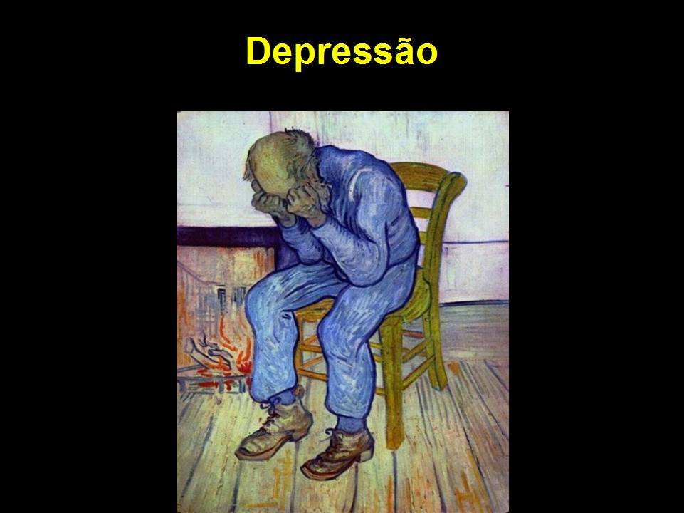

Slide 44
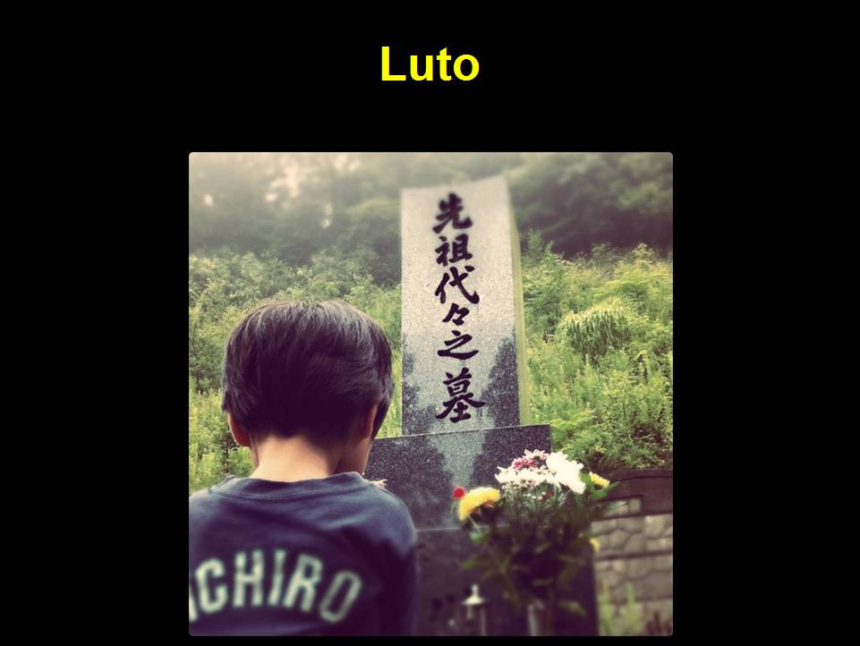

Slide 45
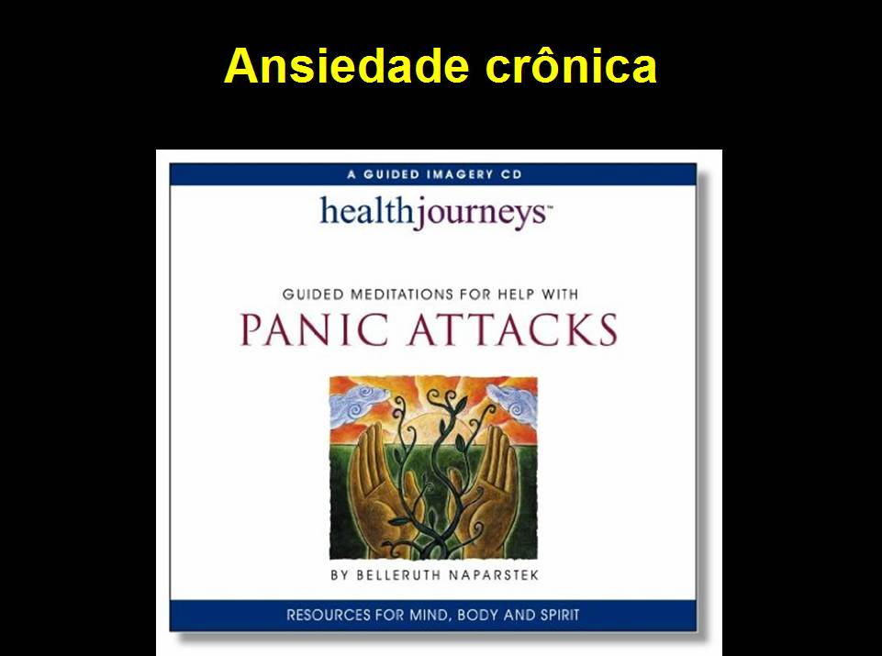

Slide 46
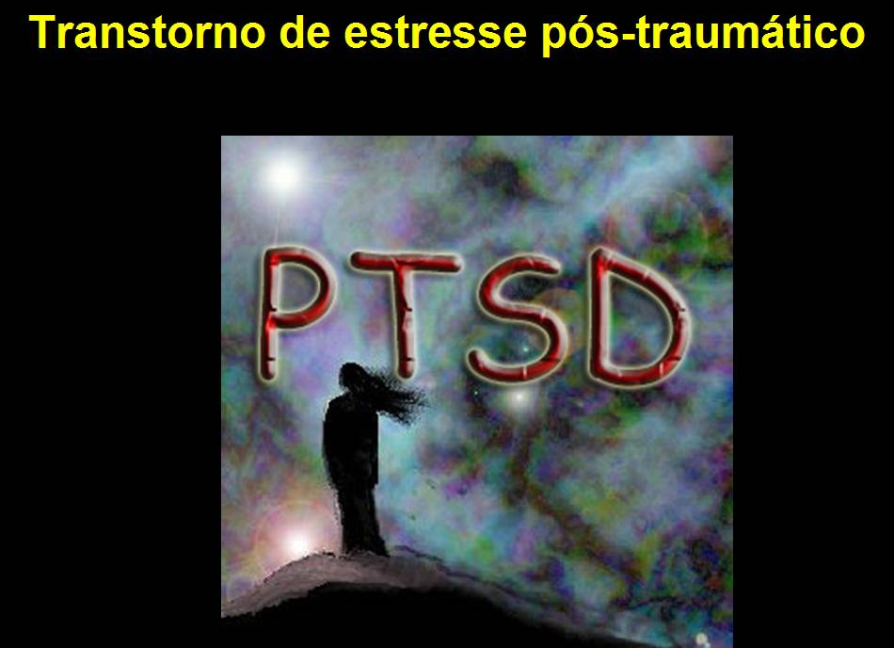

Slide 47
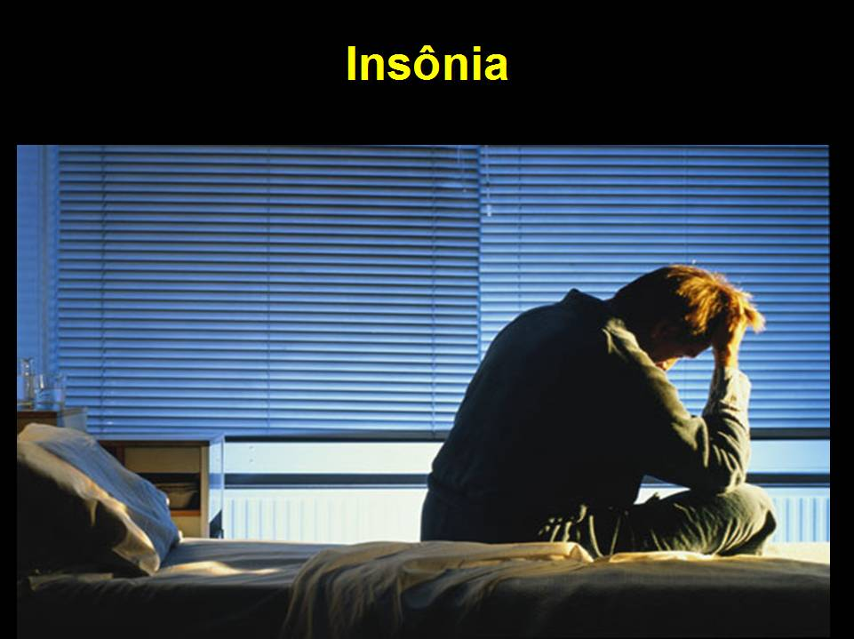

Slide 48
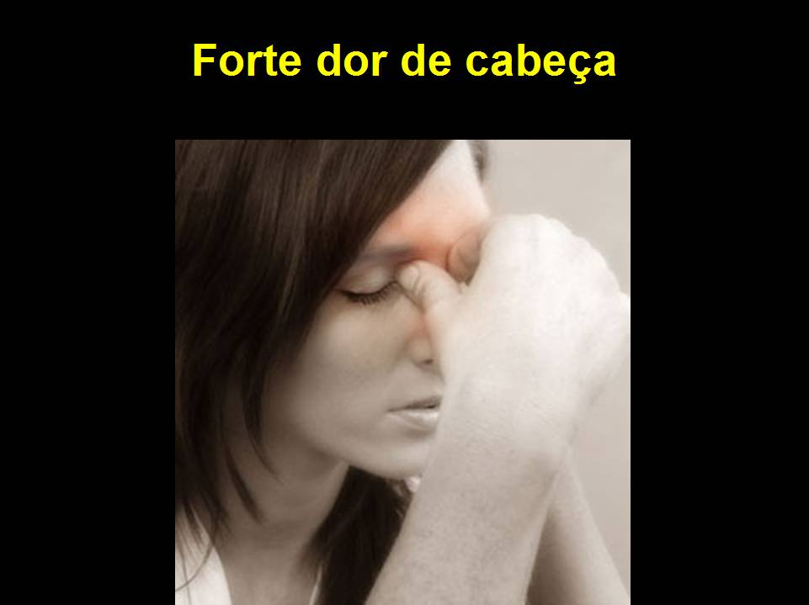

Slide 49
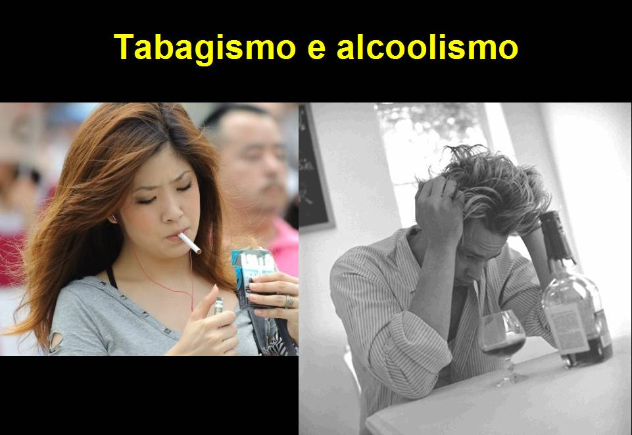

Slide 50
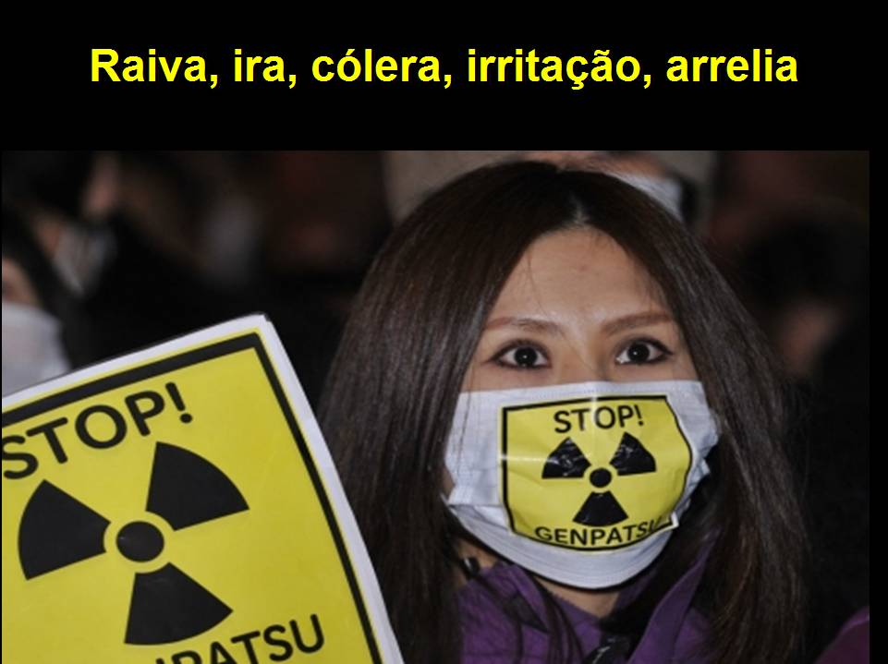

Slide 51
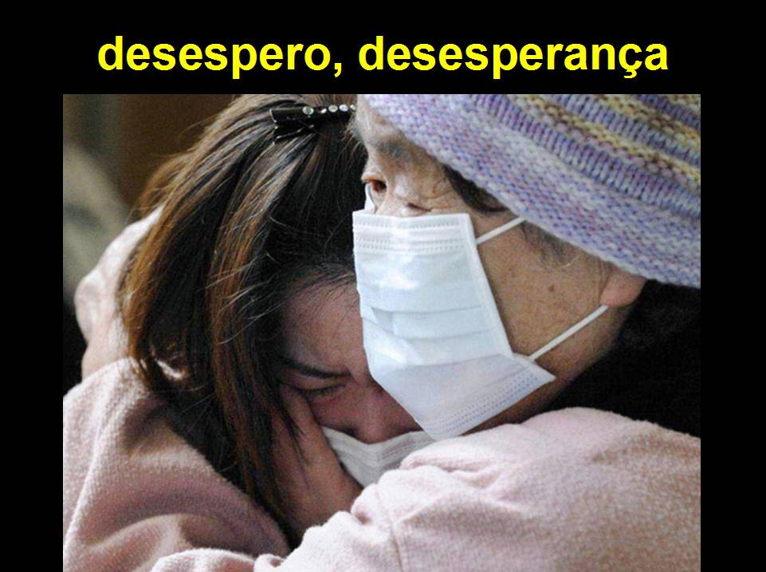

Slide 52
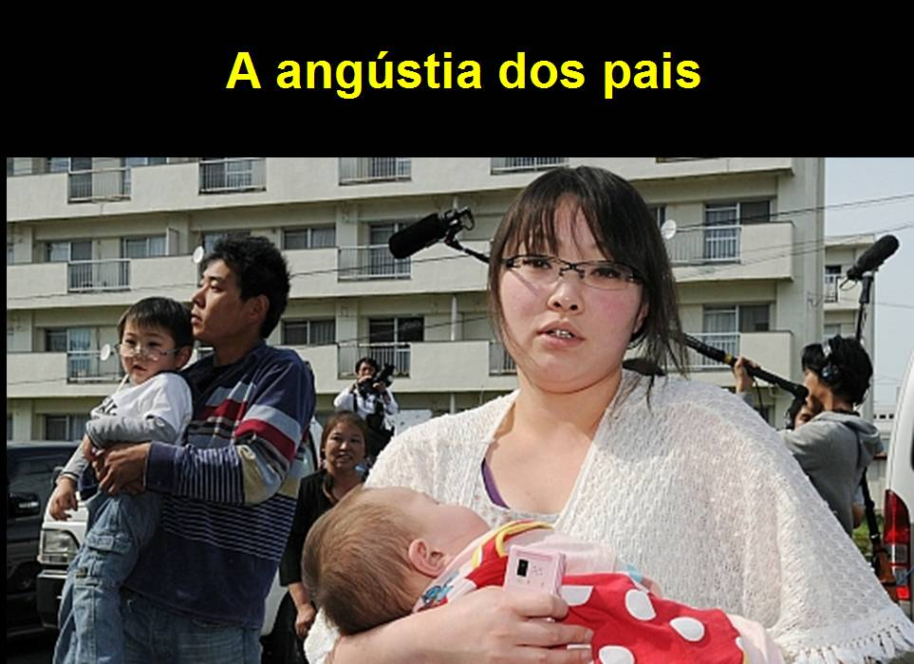

Slide 53
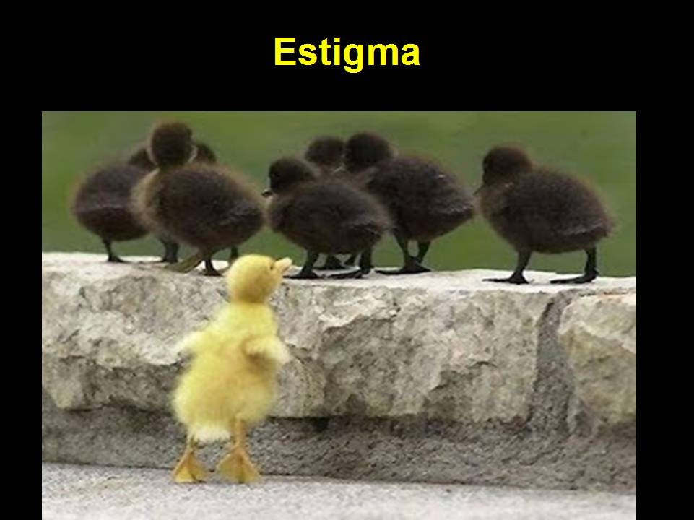

Slide 54
Radiações, radiações ionizantes, atividade radioativa e dose de radiação – relacionamentos

Slide 55
1 Bq = 1 dps
1 Ci = 3,7E+10 Bq
1 Sv = 1 J/kg
Para Co-60 (incorporado) ➔ 1 Sv = 1,0E+09 Bq
1 mSv = 1,0E+06 Bq

Slide 56
Gestão e controle de trabalhos radiológicos em uma usina nuclear

Slide 57
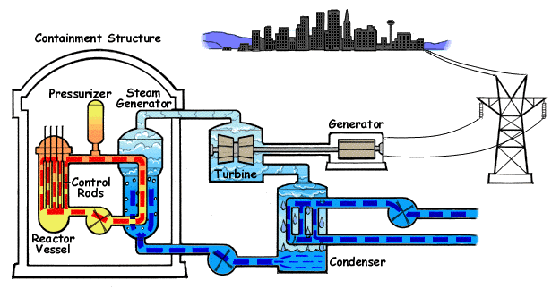

Slide 58
IAEA Safety Standards related to Radiation Protection

Slide 59
IAEA Safety Standards related to Radiation Protection
IAEA Safety Standards Series No. SF-1, Fundamental Safety Principles, presents the fundamental safety objective and principles of protection and safety.
General safety equirements to meet the fundamental safety objective and to apply the safety principles specified in SF-1, are in IAEA Safety Standards Series No. GSR Part 3, Radiation Protection and Safety of Radiation Sources: International Basic Safety Standards.
Specific safety requirements related to nuclear power plants, both for design and commissioning, are in SSR-2.1 and SSR-2.2.
Guidance on meeting the requirements of GSR Part 3 for occupational radiation protection is provided in GSG-7.
Recommendations and guidance are intended for regulatory bodies.
useful to:
  Employers, Licensees and registrants;
  Management bodies and their specialist advisers;
  Health and safety committees concerned with the radiation protection of workers.

Slide 60
Radiological safety objectives for a Nuclear Power Plants (NPP) – SF-1
The fundamental safety objective is to protect people and the environment from harmful effects of ionizing radiation.
  To control the radiation exposure of people and the release of radioactive material to the environment;
  To restrict the likelihood of events that might lead to a loss of control over a nuclear reactor core, nuclear chain reaction, radioactive source or any other source of radiation;
  To mitigate the consequences of such events if they were to occur.
Notes:
2.1. This fundamental safety objective of protecting people — individually and collectively — and the environment has to be achieved without unduly limiting the operation of facilities or the conduct of activities that give rise to radiation risks. To ensure that facilities are operated and activities conducted so as to achieve the highest standards of safety that can reasonably be achieved, measures have to be taken:

Slide 61
Radiological safety objectives for a Nuclear Power Plants (NPP) – SF-1
The fundamental safety objective applies for all activities, and for all stages over the NPP lifetime, including planning, siting, design, manufacturing, construction, commissioning and operation, as well as decommissioning and closure. This includes the associated transport of radioactive material and management of radioactive waste.
Notes:
2.2. The fundamental safety objective applies for all facilities and activities,
and for all stages over the lifetime of a facility or radiation source, including
planning, siting, design, manufacturing, construction, commissioning and operation, as well as decommissioning and closure. This includes the associated transport of radioactive material and management of radioactive waste

Slide 62
Radiation Protection aspects at the design stage for NPP – SSR-2.1
To ensure that for all operational states of a nuclear power plant and for any associated activities, doses from exposure to radiation within the installation or exposure due to any planned radioactive release from the installation are kept below the dose limits and kept as low as reasonably achievable (ALARA). In addition, it is required to implement measures for mitigating the radiological consequences of any accidents, were they to occur.
A NPP is required to be designed to keep all sources of radiation under strict technical and administrative control.
Notes:
SSR-2.1
2.6. In order to satisfy the safety principles, it is required to ensure that for all operational states of a nuclear power plant and for any associated activities, doses from exposure to radiation within the installation or exposure due to any planned radioactive release from the installation are kept below the dose limits and kept as low as reasonably achievable. In addition, it is required to implement measures for mitigating the radiological consequences of any accidents, were they to occur.
2.7. To apply the safety principles, it is also required that nuclear power plants be designed and operated so as to keep all sources of radiation under strict technical and administrative control. However, this principle does not preclude limited exposures or the release of authorized amounts of radioactive substances to the environment from nuclear power plants in operational states. Such exposures and radioactive releases are required to be strictly controlled and to be kept as low as reasonably achievable, in compliance with regulatory and operational limits as well as radiation protection requirements [4].

Slide 63
Radiation Protection aspects at the design stage for NPP – SSR-2.1
THE CONCEPT OF DEFENSE IN DEPTH - to ensure all safety related activities are subject to independent layers of provisions.
  The purpose of the first level of defense is to prevent deviations from normal operation and the failure of items important to safety.
  The purpose of the second level of defense is to detect and control deviations from normal operational states in order to prevent anticipated operational occurrences at the plant from escalating to accident conditions.
Notes:
2.13. Application of the concept of defence in depth in the design of a nuclear power plant provides several levels of defence (inherent features, equipment and procedures) aimed at preventing harmful effects of radiation on people and the environment, and ensuring adequate protection from harmful effects and mitigation of the consequences in the event that prevention fails. The independent
effectiveness of each of the different levels of defence is an essential element of defence in depth at the plant and this is achieved by incorporating measures to avoid the failure of one level of defence causing the failure of other levels. There are five levels of defence:
(1) The purpose of the first level of defence is to prevent deviations from normal operation and the failure of items important to safety. This leads to requirements that the plant be soundly and conservatively sited, designed, constructed, maintained and operated in accordance with quality management and appropriate and proven engineering practices. To meet
these objectives, careful attention is paid to the selection of appropriate design codes and materials, and to the quality control of the manufacture of components and construction of the plant, as well as to its commissioning.
Design options that reduce the potential for internal hazards contribute to the prevention of accidents at this level of defence. Attention is also paid to the processes and procedures involved in design, manufacture, construction and in-service inspection, maintenance and testing, to the ease of access for these activities, and to the way the plant is operated and to how operating
experience is utilized. This process is supported by a detailed analysis that determines the requirements for operation and maintenance of the plant and the requirements for quality management for operational and maintenance practices.
(2) The purpose of the second level of defence is to detect and control deviations from normal operational states in order to prevent anticipated operational occurrences at the plant from escalating to accident conditions. This is in recognition of the fact that postulated initiating events are likely to occur over the operating lifetime of a nuclear power plant, despite the care taken to prevent them. This second level of defence necessitates the provision of specific systems and features in the design, the confirmation of their effectiveness through safety analysis, and the establishment of operating procedures to prevent such initiating events, or else to minimize their consequences, and to return the plant to a safe state.
(3) For the third level of defence, it is assumed that, although very unlikely, the escalation of certain anticipated operational occurrences or postulated initiating events might not be controlled at a preceding level and that an accident could develop. In the design of the plant, such accidents are postulated to occur. This leads to the requirement that inherent and/or engineered safety features, safety systems and procedures be provided that are capable of preventing damage to the reactor core or significant off-sitereleases and returning the plant to a safe state.
(4) The purpose of the fourth level of defence is to mitigate the consequences of accidents that result from failure of the third level of defence in depth. The most important objective for this level is to ensure the confinement function, thus ensuring that radioactive releases are kept as low as reasonably achievable.
(5) The purpose of the fifth and final level of defence is to mitigate the radiological consequences of radioactive releases that could potentially result from accident conditions. This requires the provision of an adequately equipped emergency control centre and emergency plans and emergency procedures for on-site and off-site emergency response.

Slide 64
Radiation Protection aspects at the design stage for NPP – SSR-2.1
THE CONCEPT OF DEFENSE IN DEPTH - to ensure all safety related activities are subject to independent layers of provisions.
  For the third level of defense, it is assumed that, although very unlikely, the escalation of certain anticipated operational occurrences or postulated initiating events might not be controlled at a preceding level and that an accident could develop.
  The purpose of the fourth level of defense is to mitigate the consequences of accidents that result from failure of the third level of defense in depth.
  The purpose of the fifth and final level of defense is to mitigate the radiological consequences of radioactive releases that could potentially result from accident conditions.
Notes:
2.13. Application of the concept of defence in depth in the design of a nuclear power plant provides several levels of defence (inherent features, equipment and procedures) aimed at preventing harmful effects of radiation on people and the environment, and ensuring adequate protection from harmful effects and mitigation of the consequences in the event that prevention fails. The independent
effectiveness of each of the different levels of defence is an essential element of defence in depth at the plant and this is achieved by incorporating measures to avoid the failure of one level of defence causing the failure of other levels. There are five levels of defence:
(1) The purpose of the first level of defence is to prevent deviations from normal operation and the failure of items important to safety. This leads to requirements that the plant be soundly and conservatively sited, designed, constructed, maintained and operated in accordance with quality management and appropriate and proven engineering practices. To meet
these objectives, careful attention is paid to the selection of appropriate design codes and materials, and to the quality control of the manufacture of components and construction of the plant, as well as to its commissioning.
Design options that reduce the potential for internal hazards contribute to the prevention of accidents at this level of defence. Attention is also paid to the processes and procedures involved in design, manufacture, construction and in-service inspection, maintenance and testing, to the ease of access for these activities, and to the way the plant is operated and to how operating
experience is utilized. This process is supported by a detailed analysis that determines the requirements for operation and maintenance of the plant and the requirements for quality management for operational and maintenance practices.
(2) The purpose of the second level of defence is to detect and control deviations from normal operational states in order to prevent anticipated operational occurrences at the plant from escalating to accident conditions. This is in recognition of the fact that postulated initiating events are likely to occur over the operating lifetime of a nuclear power plant, despite the care taken to prevent them. This second level of defence necessitates the provision of specific systems and features in the design, the confirmation of their effectiveness through safety analysis, and the establishment of operating procedures to prevent such initiating events, or else to minimize their consequences, and to return the plant to a safe state.
(3) For the third level of defence, it is assumed that, although very unlikely, the escalation of certain anticipated operational occurrences or postulated initiating events might not be controlled at a preceding level and that an accident could develop. In the design of the plant, such accidents are postulated to occur. This leads to the requirement that inherent and/or engineered safety features, safety systems and procedures be provided that are capable of preventing damage to the reactor core or significant off-sitereleases and returning the plant to a safe state.
(4) The purpose of the fourth level of defence is to mitigate the consequences of accidents that result from failure of the third level of defence in depth. The most important objective for this level is to ensure the confinement function, thus ensuring that radioactive releases are kept as low as reasonably achievable.
(5) The purpose of the fifth and final level of defence is to mitigate the radiological consequences of radioactive releases that could potentially result from accident conditions. This requires the provision of an adequately equipped emergency control centre and emergency plans and emergency procedures for on-site and off-site emergency response.

Slide 65
Radiation Protection aspects during the operation of a NPP – SSR-2.2
THE MANAGEMENT AND ORGANIZATIONAL STRUCTURE OF THE OPERATING ORGANIZATION
  Requirement 1: Responsibilities of the operating organization - The operating organization shall have the prime responsibility for safety in the operation of a nuclear power plant.
  Requirement 2: Management system - The operating organization shall establish, implement, assess and continually improve an integrated management system.
  Requirement 3: Structure and functions of the operating organization. Requirement 4: Staffing of the operating organization.
  Requirement 5: Safety policy - The operating organization shall establish and implement operational policies that give safety the highest priority.
  Requirement 6: Operational limits and conditions

Slide 66
Radiation Protection aspects during the operation of a NPP – SSR-2.2
THE MANAGEMENT AND ORGANIZATIONAL STRUCTURE OF THE OPERATING ORGANIZATION
  Requirement 7: Qualification and training of personnel
  Requirement 8: Performance of safety related activities - The operating organization shall ensure that safety related activities are adequately analyzed and controlled to ensure that the risks associated with harmful effects of ionizing radiation are kept as low as reasonably achievable.
  Requirement 9: Monitoring and review of safety performance
  Requirement 10: Control of plant configuration -

Slide 67
Radiation Protection aspects during the operation of a NPP – SSR-2.2
THE MANAGEMENT AND ORGANIZATIONAL STRUCTURE OF THE OPERATING ORGANIZATION
  Requirement 11: Management of modifications
  Requirement 12: Periodic safety review
  Requirement 13: Equipment qualification
  Requirement 14: Ageing management
  Requirement 15: Records and reports
  Requirement 16: Program for long term operation
OPERATIONAL SAFETY PROGRAMMES
  Requirement 17: Consideration of objectives of nuclear security in safety programmes
  Requirement 18: Emergency preparedness
  Requirement 19: Accident management programme

Slide 68
Radiation Protection aspects during the operation of a NPP – SSR-2.2
OPERATIONAL SAFETY PROGRAMMES
Requirement 20: Radiation protection - The operating organization shall establish and implement a radiation protection programme.
  5.10. …shall ensure…compliance with GSR Part 3 …shall verify, by … surveillance, inspections and audits … the … programme is … correctly implemented and … objectives are being met. The radiation protection programme shall be reviewed on a regular basis and updated if necessary.
  5.11. …shall ensure … for all operational states, doses … in the plant or … due to any planned releases of radioactive material from the plant are kept below authorized limits and are as low as reasonably achievable.
  5.12. …shall have sufficient independence and resources to be able to enforce and to advise on radiation protection regulations, standards and procedures, and on safe working practices.
  5.13. All plant personnel shall understand and acknowledge their individual responsibility …for controlling exposures that are specified in the radiation protection programme. …emphasis shall be given to the training of all site personnel … of radiological hazards and … necessary protective measures.

Slide 69
Radiation Protection aspects during the operation of a NPP – SSR-2.2
OPERATIONAL SAFETY PROGRAMMES
Requirement 20: Radiation protection - The operating organization shall establish and implement a radiation protection program.
  5.14. All site personnel, including contractors…shall have their occupational exposures assessed ... Dose records shall be kept and … available to personnel on demand and to the regulatory body.
  5.15. …shall include the health surveillance … for ascertaining their physical fitness and for giving advice in cases of accidental overexposure. This health surveillance shall consist of a preliminary medical examination followed by periodic checkups.
  5.16. …shall ensure control over radiation dose rates for exposures due to activities in areas where there is radiation arising from or passing through structures, systems and components, such as in inspection, maintenance and fuel handling. It also addresses plant chemistry activities as well as exposures due to radioactivity of substances in the fuel coolant (liquid or gas) and associated fluids. The program shall make arrangements to maintain these doses as low as reasonably achievable.

Slide 70
Radiation Protection aspects during the operation of a NPP – SSR-2.2
Requirement 21: Management of radioactive waste - The operating organization shall establish and implement a programme for the management of radioactive waste.
  5.17. …ensure that the generation of radioactive waste is kept to the minimum practicable in terms of both activity and volume.
  5.18. …shall establish and implement a programme for the management of radioactive waste…include the pretreatment, characterization, classification, treatment, conditioning, transport, storage and disposal of radioactive waste, as well as regular updating of the inventory of radioactive waste…Records shall be maintained for waste generation and waste classification, as well as for the storage, treatment and disposal of waste.
  5.19. …establish and implement procedures consistent with international standards, national regulations and licence conditions for the monitoring and control of discharges of radioactive effluents. These procedures shall be made available to the regulatory body if required. The volume and activity of radioactive discharges to the environment shall be reported periodically to the regulatory body.
  5.20. …shall ensure that a programme is established and implemented for monitoring the environment in the vicinity of the plant site, to assess radiological consequences of any radioactive releases to the environment. Results from this monitoring shall be made available to the public, and in particular to the public living in the vicinity of the plant site.
Requirement 22: Fire safety
Requirement 23: Non-radiation-related safety –
Requirement 24: Feedback of operating experience

Slide 71
Radiation Protection Program in a NPP
Specific Objectives:
  To control access & work in contaminated areas and radiation areas;
  To control direct and indirect exposure of radiation worker to ionizing radiation;
  To control the exposure of radiation worker to airborne radioactivity;
  To control infrequent and cumulative personal exposure to radiation, taking into account personal exposure history;
  To conduct radiological monitoring of nuclear plant areas to determine current levels of radiation and contamination and trends at such levels;
  To apply methodologies to achieve the goals of ALARA planning;
  To keep control over the movement and storage of radioactive and contaminated materials,
  To provide training for the radiation worker in radiation protection;
  To carry out, at the appropriate frequency, maintenance, tests, inspections and training necessary so that the objectives can be reached, and the radiological safety is maintained in all operating conditions of the Control Unit.

Slide 72
Radiation Protection Program in a NPP
Generic Description of a NPP:
  Reactor Building with Containment;
  Auxiliary Buildings, containing Emergency Cooling Equipment, Volumetric Control Tanks, Filters and Resins Systems, Waste Processing Systems, Hot Workshop, Chemistry Laboratory (Radiochemistry), Test Source Storage, Radiological Control Point etc;
  Control Building (Control Room);
  Turbine and electric generator building;
  Buildings of Diesel Generators.

Slide 73
Radiation Protection Program in a NPP
Radiation Sources in a NPP:
  Fission Products - Ex. Cesium-137, I-131, noble gases etc. They are generated in the fuel and, in case of failures, can be carried through the reactor coolant to the treatment systems and auxiliary systems.
  Activated Corrosion Products - Resulting from corrosion processes on the inner surfaces of the Primary System, are carried throughout the Reactor Cooling System. During the stay they are suspended in the reactor coolant, they can be activated through the neutron fluence, becoming radioactive.
  Activation Products - The most important for the risk is the nitrogen-16 isotope, which originates from the activation of oxygen. This isotope is used as a reference for design calculations of primary system shields due to its high energy range (6 to 8 MeV). It is also used to alarm any type of accident that involves leaking from the primary system to the secondary system. Other short-time activation products can be formed: N-17, O-19, N-13, F-18 and Na-24, from reactions with the reactor coolant and its impurities.
  Tritium - The three main processes of tritium formation in reactor coolant are:
    Diffusion of tritium produced by ternary fission through the coating of the fuel;
    Neutron capture reactions by Boron and Lithium in the Coolant of the Reactor;
    Activation of Deuterium in Reactor Coolant.

Slide 74
Radiation Protection Program in a NPP
  Safety & Control Systems
    The safety philosophy of a nuclear power plant takes into account the special risks arising from the presence of nuclear radiation, the generation and accumulation of fission and activation products. Safety features are designed in such a way that a required degree of occupational radiation protection is ensured at all times and that inadmissible amounts of radioactivity are not released to the environment during the authorized operation or during and after postulated accidents.
    In particular, it must be ensured that in all operational or accident conditions at the nuclear plant, the following safety objectives will be achieved:
      Safe shutdown of the reactor and long period of subcriticality;
      Long period of residual heat removal;
      Confinement of radioactivity.
  PASSIVE BARRIERS
    Concept of Defense in Depth:
      Fuel pellets;
      Fuel Tube;
      Cooling system of the reactor;
      Containment.

Slide 75
Radiation Protection Program in a NPP
  Optimization System
    Aims to perform the radiological control minimizing the doses, through procedures to control the work.
    Dose minimization is based on the LNT approach.
    The established dose control is performed through personal monitoring, establishing dose constraints, identifying and controlling the sources of radiation and tracking the doses received. In addition, dose control is performed through work planning and management to reduce unnecessary doses, such as reduced working time and appropriate use of other radiation protection measures.
    The operational limits of dose are intended to prevent any radiation worker receiving dose that may threaten the official limits in force in the country.
    Dose constraints and administrative controls are tools to ensure that individual doses are fairly distributed among the individuals responsible for performing similar services and that collective doses are minimized.
    Radiometric surveys, aimed to identify sources of radiation and contamination in the facilities, are performed providing the basis for actions to protect the worker against radiation and radioactive contamination.

Slide 76
Radiation Protection Program in a NPP
  Optimization System
    Separation of areas according to the level of risk. The risk classifications are defined according to the values ​​found during the monitoring of the areas.
    Depending on the classification, access to the compartments within the Controlled Areas is subject to restrictions, additional controls or even to be blocked, preventing unnecessary exposures.
    Eating, drinking, chewing and smoking are prohibited within the Controlled Areas to minimize the risk of internal contamination from ingestion of radioactive materials.
    Work control is achieved by establishing radiological responsibilities and standards using first-line supervisors and Radiological Protection personnel to monitor the performance of work in the Controlled Areas of the Central, providing worker through radiological work permits instructions protection measures to be used during specific work.
    Challenging annual goals lower than those established in the project are used in order to actively involve all of the plant´s organizational units in dose reduction actions.
    As a limiting optimization condition, a dose restriction is established for the individual from the most exposed public, as a function of the effluent releases from each Central plant.

Slide 77
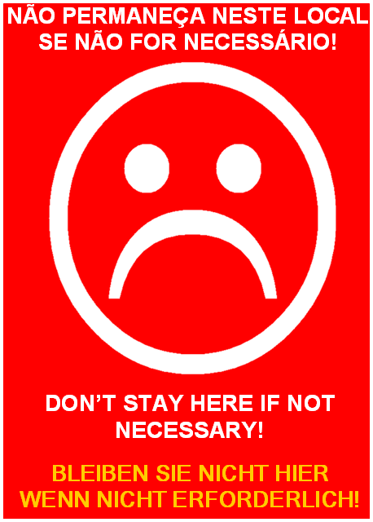


Slide 78
Structure and key elements of RP program
ALARA COMMITTEE
Work Control
Radiation Instrum. Calibration
Dosimetry
Training
ALARA Planning
Respiratory Protection
Environm.
Radiation Protection Officer
Plant Manager
Operations
Maintenance
Engineering
Other
Radwaste & Transp.
EPR

Slide 79
Structure and key elements of RP program
Work Control
  Monitoring of radiological work and implementation of work planning requirements;
  Installation of temporary shield;
  Systematic control of radiation doses of radiation worker;
  Monitoring of all releases of effluents from the plant;
  Implementation of respiratory protection of radiation worker against radioactive airborne materials;
  Decontamination of people and coordination / orientation of the decontamination of materials and surfaces of the plant;
  Release of materials from the Controlled Areas to areas free of radiological control;
  Routine and special radiological mapping with respect to radiation levels, surface contamination and air contamination in work environments.

Slide 80
Structure and key elements of RP program
Radiation Instrumentation Calibration
  Calibration, controls, records and maintenance of all the instrumentation used by the Radiological Protection Service;
  Control, records and inventory of radioactive sources owned by the Nuclear Power Plant.
Dosimetry
  Evaluation and control of personal external and / or internal doses;
  Control of the distribution of personal and area dosimeters;
  Control of dose and contamination records of all occupational workers of the Nuclear Power Plant.

Slide 81
Structure and key elements of RP program
Radwaste & Transportation
  Accounting, control and registration of solid wastes and effluents by the treatment processes from de plant;
  Calculation of the effective dose in the critical group;
  Management of initial storage of radwaste;
  Transport of radioactive materials in areas outside the plant areas.
Training
  Technical and administrative coordination of the Training Program for Qualification and Retraining of the technical staff of Radiological Protection Organization;
  Provide training and retraining to employees in general.

Slide 82
Structure and key elements of RP program
ALARA Planning
  Prepare, control and record ALARA planning;
  Keep minutes of plant´s ALARA meeting;
  Maintain inventory of temporary shields and control their effectiveness;
  Analyze and propose ALARA recommendations for optimization of individual and collective doses of the facilities.

Slide 83
Structure and key elements of RP program
Respiratory Protection
  Maintain and control the respiratory protection equipment of the Radiological Protection Service;
  Conduct qualitative and quantitative assessments of the worker adaptation regarding the use of masks;
  Keep self-contained breathing apparatus (SCBA) operable.
Emergency Preparedness and Response
  Maintain inventory, inspect regularly, and ensure the perfect state of Local Emergency Plan emergency kits;
  Integrate the EPR Team.

Slide 84
Structure and key elements of RP program
Environmental Monitoring
  To carry out environmental monitoring programs, monitoring the evolution of physical, biological, chemical and radiological parameters in order to verify the influence of the plants, including the initial storage of radioactive waste, for the environment and the potential environmental impacts produced.

Slide 85
Structure and key elements of RP program
Radiological Control Point
  Carry out radiological controls for entry and exit of personnel and materials from the Controlled Areas;
  Preparation, monitoring, control and temporary filing of documents and records generated, such as:
    Radiation work permit;
    survey records;
    Keeping data from process and activity monitors and records of tasks performed among other administrative controls.

Slide 86
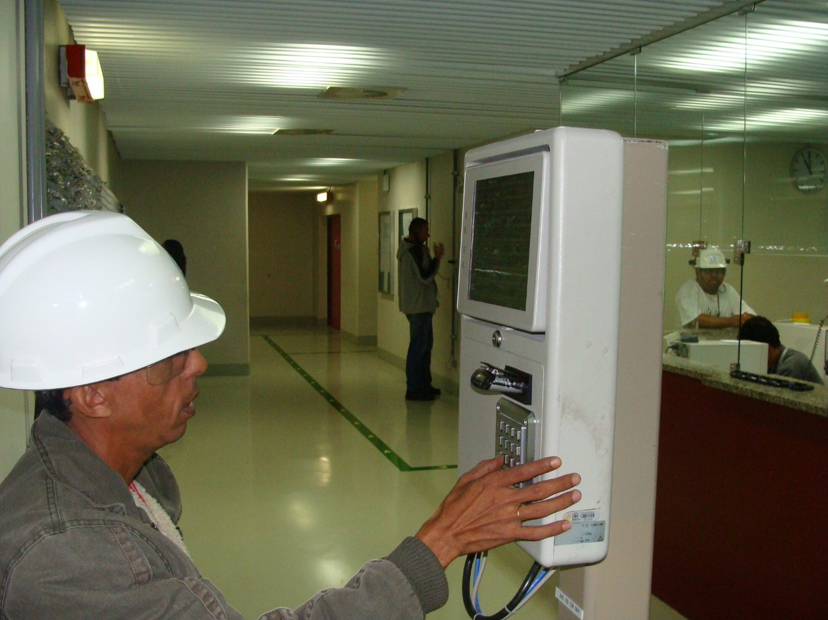

Slide 87
Structure and key elements of RP program
Changing Clothes Area
  Area close to the Control Point of each NPP, facilitating the verification and possible correction of the appropriate use of the special clothing by the Radiation Protection Service team. At these locations, special clean clothing (cloth overalls, cotton gloves, rubber gloves, cloth cap and cloth slippers) used by the worker in areas subject to contamination in the Controlled Area is stored and made available for use.

Slide 88
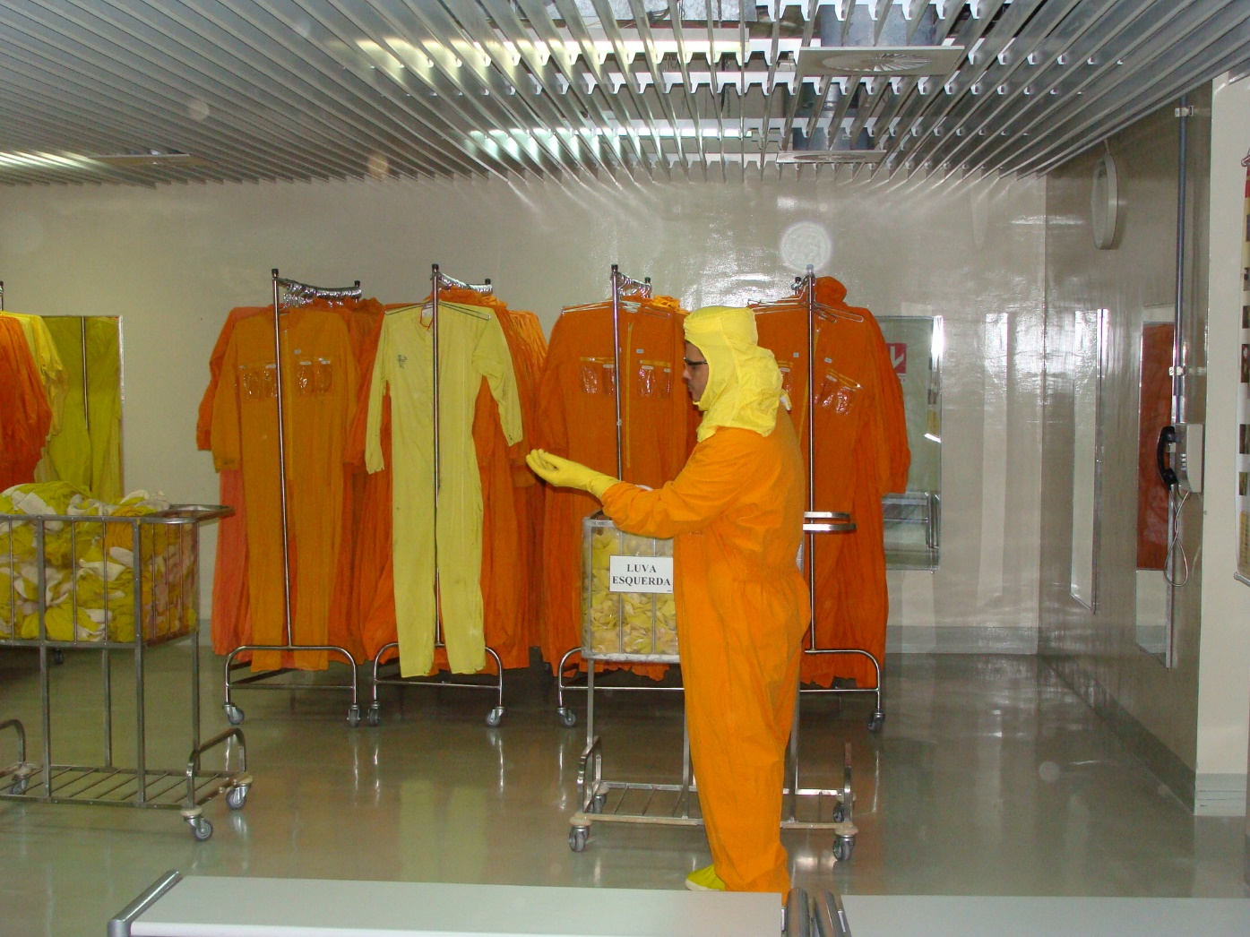

Slide 89
Structure and key elements of RP program
Personal Contamination Control
  Area for the detection and assessment of possible external radioactive contamination in each worker at the exit of the Controlled Area.
  In this area, the worker is monitored through portal contamination monitors, with the capability of locating the contamination in each monitored individual, as well as automatically blocking the exit of the same in the event of an alarm.

Slide 90
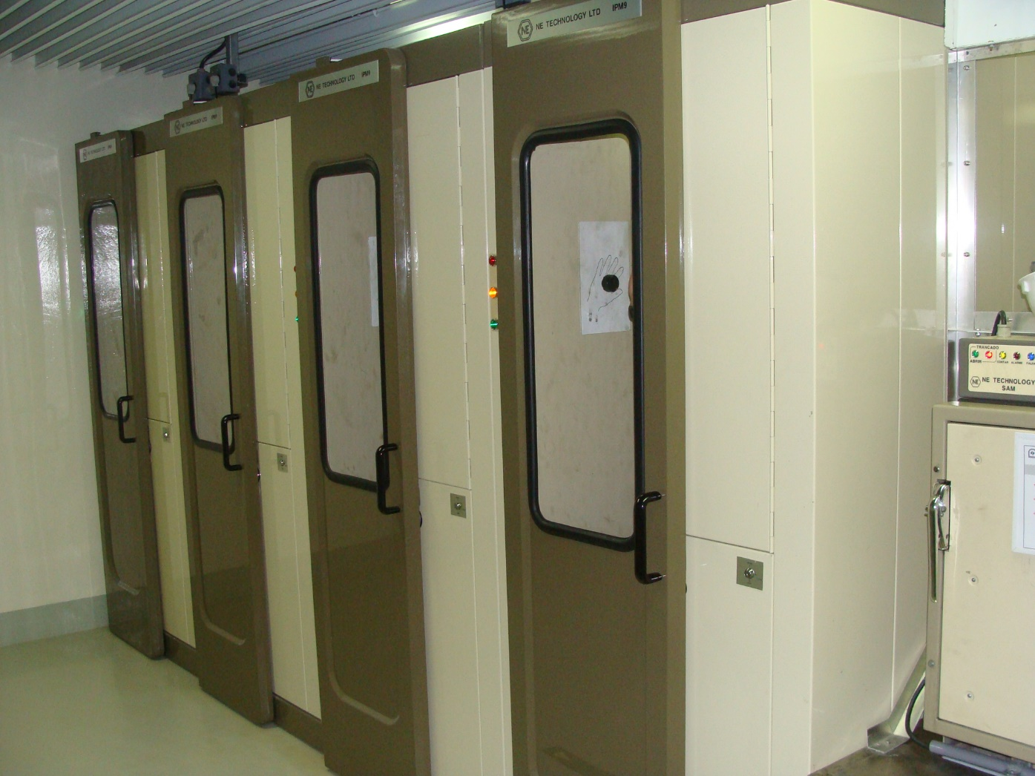

Slide 91
Structure and key elements of RP program
Personal Decontamination Area
  Area prepared for external decontamination of the radiation worker. In these places are available for use, shower boxes and utensils for whole person baths, sinks and tables, as well as decontamination kits for personal needs. This place is located inside the Controlled Area of ​​the plants, near the Control Point.

Slide 92
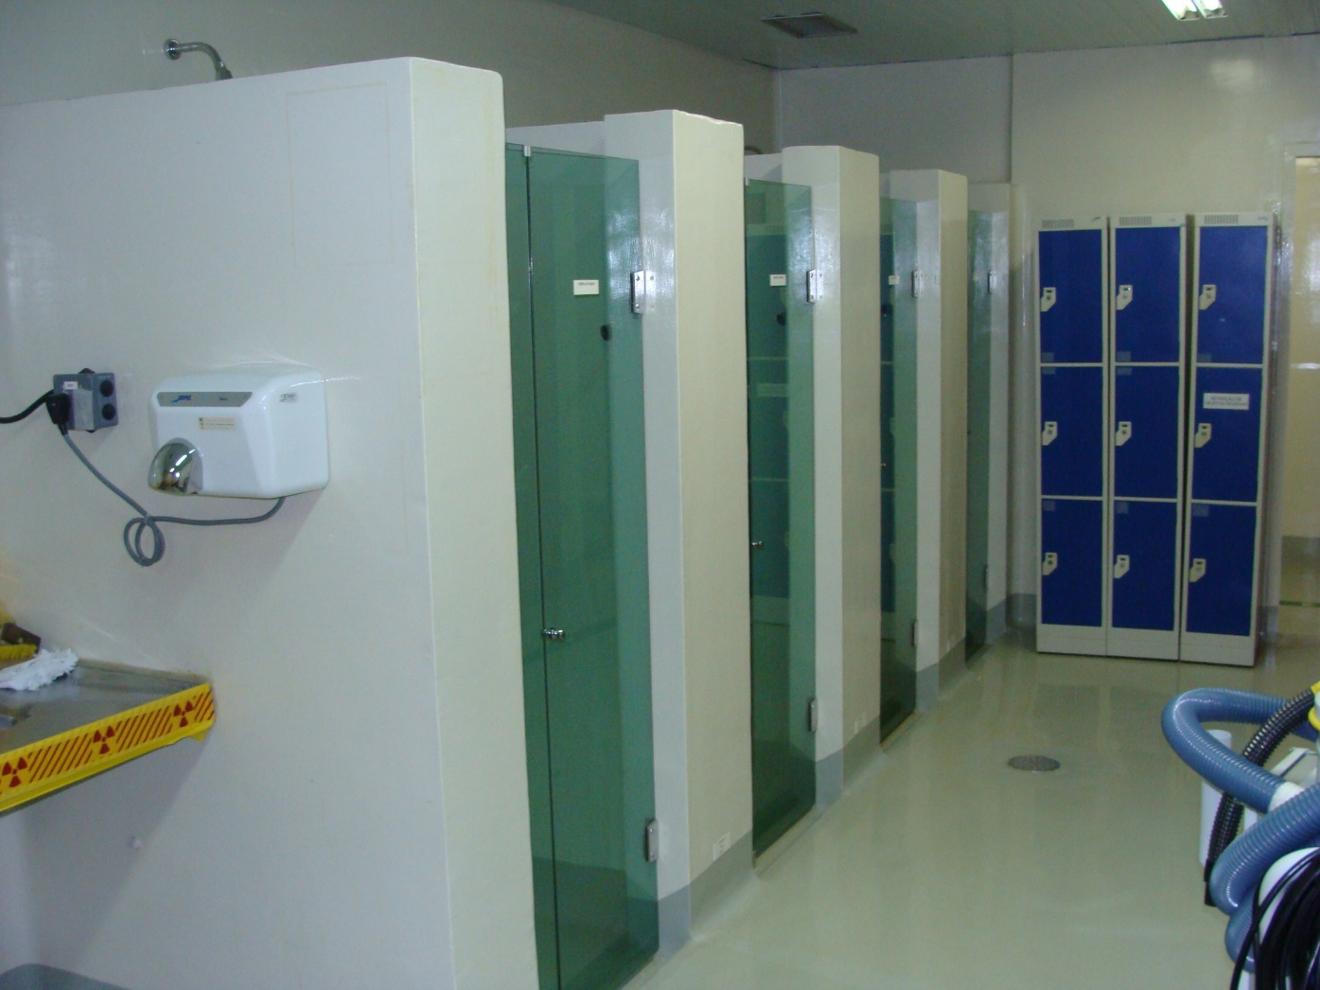

Slide 93
Structure and key elements of RP program
Decontamination Facility / Laundry
  Decontamination of parts, tools and equipment;
  Decontamination of special clothing used by the worker,
  Hygiene and possible decontamination of masks / respiratory protection equipment.
  Located inside the Controlled Area of ​​the plant, in places of easy access to allow the handling and movement of the pieces and equipment according to the places of use or application.

Slide 94
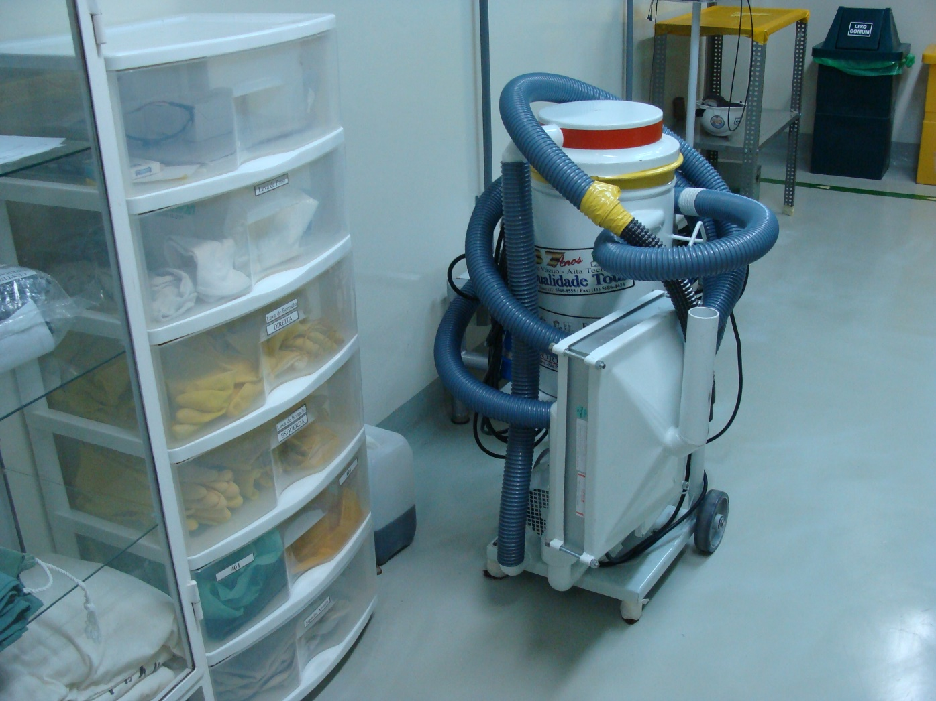

Slide 95
Structure and key elements of RP program
Counting Room
  Areas for routine evaluations involving the program of surface monitoring and analysis of samples with the possibility of containing radioactive substances.

Slide 96
Structure and key elements of RP program
Required Equipment
  Portable radiation monitors for different types of radiation (alpha, beta, gamma and neutrons);
  Portable contamination monitors;
  Alpha, beta and gamma counting systems;
  Spectrometric analysis system of samples;
  Fixed monitors for personal and object contamination;
  Respiratory protective equipment;
  Personal protective (clothes) equipment against radioactive contamination;
  Area dosimetry using thermoluminescent or equivalent dosimeters.

Slide 97
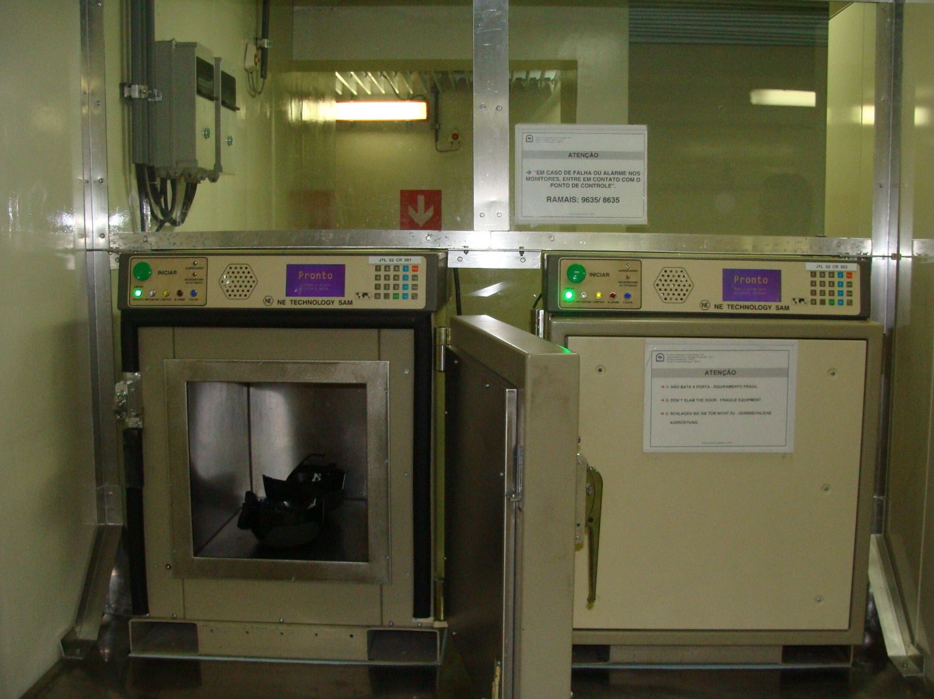

Slide 98
Conclusions
The radiation protection Program is a fundamental organization for any Nuclear Power Plant organization.
Independence from operating organizations is crucial.
Qualified staff, sufficient resources, adequate facilities and comprehensive program and procedures aligned both with international standards and national regulations, all them enable RP organization to fulfill its mission.
Use of operating experience, safety reviews, use of kpi´s, challenging goals, strong safety culture, use of error prevention tools and effective defenses management can set the RP organization in a position of excellence.

Slide 99
Gerenciamento de Defesas + Redução de Erros ➔ Zero acidentes

Slide 100
Ferramentas de Redução de Erros

Slide 101
Papel do líder na proteção radiológica dos trabalhadores

Slide 102

Fundamentos de Desempenho Humano & Ferramentas Para Redução de Erros

Slide 103
OBJETIVO
FORNECER AOS LÍDERES E GESTORES NOÇÕES SOBRE OS FUNDAMENTOS DA PERFORMANCE DAS
PREVENIR, DE FORMA PROATIVA, EVENTUAIS FALHAS & ACIDENTES INICIADOS POR ERROS HUMANOS.

Slide 104
Por quê Desempenho Humano?
Três em quatro eventos significantes são devidos a erros humanos
70% das causas são devidas a deficiências na organização
Contribui significativamente com os custos

Slide 105
Porquê Desempenho Humano?
50% dos eventos significantes são causados por pessoal suplementar
25% dos eventos de maior monta envolveram falta de acompanhamento apropriado da supervisão

Slide 106
O que você Gerencia?
Recursos: pessoas, instalação e propriedade
Risco: erro humano
Exposição: “Pessoa tocando equipamento”
Risco: probabilidade e consequências
Evento: ▼ frequência e ▼ severidade
Controles (alavancas):
  taxa de erro (frequência) → reduz erros ativos
  defesa em profundidade (severidade) → reduz condições latentes

Slide 107

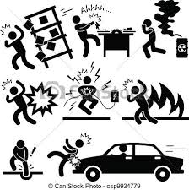

ESTRATÉGIA EM DUAS PONTAS
R_{e} + G_{d} → ØE
Reduzindo Gerenciando ZERO
leva
a
e
o erro defesas Eventos

Slide 108
Estratégia – Duas Pontas
R_{e}
Frequência
G_{d}
Redução da
Taxa de Erro
Severidade
Localizando & Eliminando
Condições Latentes
Uso Rigoroso das
Ferramentas R.E.
Agressivo Controle da
Defesa em Profundidade
Preparação do trabalho
Desempenho do Trabalho
Feedback do Trabalho
Controles de Engenharia
Controles Administrativos
Controles Culturais
Controles de Supervisão
Livre de Erro
(erro ativo)
Livre de Evento
(condições latentes)

Slide 109
ANATOMIA DE UM EVENTO
Defesas
Danificadas
Crenças & Valores
Crenças & Valores
Missão
Metas
Políticas
Processos
Programas
EventO
Ações
Iniciadoras
Deficiências
Organizacionais
Latentes
Precursores
de Erros
Notes:
Ask will time pressure ever go away?
Event - an undesirable consequence (change in state of structures, systems, and components) to the plant generally in terms of reduced safety margin; Other definitions: an outcome that must be undone; any plant condition that does not achieve its goals; a difference between what is and what ought to be
Initiating Action - an action (behavior) by an individual, either correct or in error, that results in a plant event (includes active errors that have immediate, observable, undesirable outcomes in the physical plant)
Error Precursors – (direct attention to yellow cards) undesirable conditions, prior to the action, that reduce the opportunity for successful behavior at the jobsite, prompting behavior different than intended or required, i.e., provoke or drive errant behaviors; usually embedded in task demands, work environment, individual capabilities, and human nature. Ask which of these can we effect or change?
Flawed Defenses - defects with defensive measures that, under the right circumstances, may fail to protect plant equipment or people against hazards, and fail to prevent the occurrence of active errors, violations, or at-risk behaviors.
Latent Organizational Weaknesses - undetected deficiencies in the management control processes (e.g., strategy, policies, work control, training, and resource allocation) or values (shared beliefs, attitudes, norms, and assumptions) creating workplace conditions that either provoke error (precursors) or degrade the integrity of defenses (flawed defenses)
Dual Strategy
1) Anticipate and prevent active errors (reduce number of shots on goal). (Prevents one event)
2) Discover and eliminate latent organizational weaknesses (proactive and offensive). (May prevent many events)
What’s manageable? (occur before the error and event in time)
“Events are not typically the outcome of one person’s action. More commonly, it is the result of a combination of faults in management and organizational activities.” (Turner & Pidgeon, Man-Made Disasters, p.89)

Slide 110

EXECUÇÃO DE TRABALHO
EVITANDO ERROS ATIVOS NO TRABALHO, R_{E}
Preparação do Trabalho
  planejamento, inspeções do local, distribuição de tarefas e instruções preliminares
Desempenho (Execução) do Trabalho
  atenção, domínio da situação, ferramentas R.E., trabalho em equipe e supervisão
Feedback do Trabalho
  Relatório e observações

Slide 111
DEFESA EM PROFUNDIDADE,
ELIMINANDO CONDIÇÕES LATENTES, G_{D}
Controles de Engenharia
  Confiabilidade do equipamento, configuração de software & hardware, interfaces homem-máquina
Controles Administrativos
  procedimentos, treinamento, processos, políticas e expectativas
Controles Culturais
  pressupostos, crenças, valores, atitudes, normas de trabalho em grupo, liderança
Controles de Supervisão
  disponibilidade, melhoria de desempenho

Slide 112
PRINCÍPIOS
DA GERÊNCIA DO DESEMPENHO HUMANO
Humanos são falíveis . . .
O Erro é predizível. . .
A Organização influencia o comportamento
Comportamentos são reforçados
Eventos são evitáveis.

Slide 113

ARMADILHAS DA NATUREZA HUMANA
Stress
Falta de concentração
Modelos mentais imprecisos
Memória de trabalho limitada
Recursos de atenção limitados
Falsas impressões
Dificuldade para ver os próprios erros
Perspectiva limitada
Susceptibilidade emocional
Foco na meta
Fadiga
Notes:
9

Slide 114
ERROS ATIVOS E LATENTES
Erro Ativo – uma ação que altera equipamento, sistema ou status da planta, iniciando de imediato resultados indesejados.
Erro Latente – um ato ou decisão imperceptível ao indivíduo, que resulta em uma condição latente (oculta) até ser revelada posteriormente…
Condição Latente – [condições] não detectadas criadas pelos erros latentes passados …permanece dormente…não causa dano aparente.

Slide 115
SITUAÇÃO DE ERRO-PROVÁVEL
O “Capeta” em Detalhes!
Situação de
Erro
provável
Condições locais
Ambiente
Individual
Desvios não-
Intencionais do
Comportamento
preferido
Grau de desacerto devido aos
precursores de erro
Fonte: Swain & Guttmann. Handbook of Human Reliability
Analysis with Emphasis on Nuclear Power Plant Applications.
U.S. Nuclear Regulatory Commission (NUREG/CR-1278), 1983.

Slide 116
PRECURSORES DO ERRO
Demandas da Tarefa
Ambiente do Trabalho
Capacidades Individuais
Natureza Humana
Notes:
2

Slide 117
PRECURSORES DO ERRO lista reduzida
Demandas de Tarefa
Capacidades Individuais
Pressão do tempo (muita pressa)
Falta de familiaridade com a tarefa / 1a. vez
Alta carga de trabalho (requisitos de memória)
Falta de conhecimento (modelo mental)
Tarefas simultâneas, múltiplas tarefas
Nova técnica não usada antes
Ações repetitivas, monótonas
Hábitos imprecisos de comunicáção
Atos irrecuperáveis
Ausência de proficiência / inexperiência
Requisitos de interpretação
Pouca habilidade para solução de problemas
Metas obscuras, regras & responsabilidades
Atitude “insegura” para tarefas críticas
Ausência de padrões ou padrões obscuros
Doença / Fadiga
Ambiente de Trabalho
Natureza Humana
Distrações / Interrupções
Stress (limita a atenção)
Alterações / desvios da rotina
Perfis de hábitos
Telas ou controles confusos
Presunções (imagem mental inacurada)
Workarounds / instrumentos fora de serviço
Complacência / Superconfiança
Resposta do sistema ocultada
Ilusão (“ajustado” para ver)
Condições inesperadas do equipamento
Percepção de risco inacurada (Pollyanna)
Ausência de indicação alternativa
Ráciocínio simplificado (desvios)
Conflitos de personalidade
Memória de curto-prazo limitada

Slide 118
MODOS DE DESEMPENHO
Alto
1/2
15 % de Erros
BC
Padrões
Imagem
Mental Inacurada
1/1.000
60 % de Erros
BR
Atenção (à tarefa)
Se - Então
Má interpretação
Fonte: James Reason. Managing the Risks
of Organizational Accidents, 1998.
25% de Erros
1/10.000 to 1/100.000
BH
88% - 90% do nosso tempo!! ---
Auto
Desatenção
Baixo
Baixo
Familiaridade (com a tarefa)
Alto

Slide 119
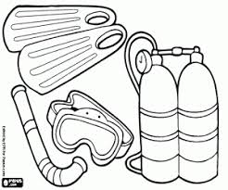

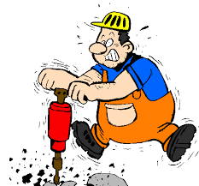
ERROS DE DEPENDÊNCIA
Equipamento
Equipe
Pessoal

Slide 120
Erros de Equipe
Efeito Halo.
Piloto / Co-piloto.
Movimento Inercial.
Preocupação com o grupo.
Grupo de risco.
Notes:
Efeito Halo – oculta a verdade da competência de indivíduos específicos devido sua experiência ou educação (como se fosse um “santo”) — Consequentemente, outras pessoas abaixam sua guarda contra erros do indivíduo competente, e a vigilância para checar as ações da pessoa respeitada enfraquecem ou cessam completamente.
Piloto/Co-Piloto – relutância de uma pessoa subordinada (co-piloto) para desafiar opiniões, decisões ou ações de uma pessoa sênior (piloto), devido à posição da pessoa em um grupo ou uma organização—Os subordinados podem expressar “excessiva cortesia profissional” quando interagem com gerentes seniores, inadvertidamente aceitando algo que o chefe diz, sem pensar criticamente sobre isto ou desafiar as ações ou conclusões da pessoa.
Movimento Inercial – a tendência para “rotular tudo” sem escrutinar ativamente a intenção e ações das pessoas que fazem o trabalho ou tomam a iniciativa — Uma outra pessoa toma a iniciativa para executar a tarefa, enquanto o indivíduo inerte assume um papel passivo na atividade.
Preocupação com o Grupo – relutância em compartilhar informação contraditória com outros membros do grupo sobre um problema, com o propósito de manter a harmonia do grupo—Isto é prejudicial para a solução de problemas críticos. Grupos altamente coesivos são susceptíveis a este tipo de erros da equipe. Usualmente, isso é piorado por um ou mais membros dominantes da equipe, que possuem considerável influência sobre o pensamento do colegiado (piloto/co-piloto ou efeito halo). Consequentemente, informações críticas conhecidas por indivíduos no grupo podem remanescer ocultas dos outros membros da equipe. O pensamento colegiado pode também resultar de excessiva “cortesia profissional”—subordinados somente informam boas notícias ou filtram informações negativas para não irritar seus chefes ou gerentes de nível mais alto.
Grupo de Risco – tendência a jogar com decisões mais como um grupo que se cada membro do grupo tomasse a decisão individualmente—A responsabilidade é difusa em um grupo. É como dizer “existe segurança nos números”. Se duas ou mais pessoas concordam que conhecem um jeito melhor para fazer algo, provavelmente irão assumir o risco de descumprir o procedimento estabelecido ou a política. Isto tem sido referido como “mentalidade de rebanho” e, no pior caso, pode ocorrer um motim.

Slide 121
MANEIRAS DE UMA AÇÃO GERAR ERRO
Deslizes e Lapsos
  Sincronismo
  Duração
  Sequência
  Objeto
  Força
Erros
Violações

Slide 122

CONTROLE POSITIVO
O que é pretendido acontecer
é o que acontece.
E isto é tudo o que acontece.

Slide 123
ALGUMAS PRÁTICAS DE RISCO:
Manuseio a dois;
Pressa;
Executando uma tarefa com diversos procedimentos;
Lendo como receita de bolo um procedimento;
Lendo enquanto controla um processo em modo manual.

Slide 124
ETAPAS CRÍTICAS
Etapa Crítica – uma etapa de procedimento, uma série de etapas, ou uma ação que, se feita inapropriadamente, causará prejuízo irreversível ao equipamento ou pessoal, ou impactará significantemente a operação da planta.
É recomendável usar uma abordagem gradual, baseada no risco, para selecionar a ferramenta de R.E. mais apropriada à situação (fluxograma lógico).

Slide 125
FERRAMENTAS DE DESEMPENHO HUMANO PARA TRABALHADORES
Ferramentas Fundamentais
Consciência Situacional
  Previsão da Tarefa
  Revisão do local de trabalho
  Atitude Questionadora
  Parar Quando em Dúvida
Auto-Verificação
Uso de Procedimento e Aderência
Comunicação Efetiva
Ferramentas Condicionais
Instrução Preliminar
Práticas de Verificação
  Verificação Concorrente
  Verificação Independente
  Verificação do parceiro de trabalho
Sinalização
Marcar o procedimento
Troca de turno
Revisão pós-trabalho

Slide 126
Defesas – Funções
Defesas degradadas permitem erros ativos ou que as suas consequências ocorram.
Físicas Administrativas
Criar Prontidão
Detectar e Avisar
Proteger
Recuperar
Conter
Habilitar Fuga
Source: Maurino (1995)
Notes:
Criam prontidão – entendendo os riscos e reconhecendo a presença de perigos; exemplos: prejob briefing, revisão pós-trabalho, avaliação de risco, procedimentos, identificação de componentes, codificação em cores, autochecagem, layout da tela de computador, registros, reuniões, práticas de comunicação, cartões de aviso, sinalização radiológica.
Detectam e avisam – alertam para a presença de condições ou perigos iminentes; exemplos: alarmes e anunciadores, rondas do operador em equipamentos, verificação concorrente, peer-checking, supervisão, metodologia de solução de problemas, requisitos de acesso para entrar em espaços confinados, autochecagem.
Protegem – guardando pessoas, equipamentos e o ambiente dos erros e ameaças; exemplos: equipamento de proteção individual, sistema de remoção de calor residual, supervisão, bloqueio de equipamentos, intertravamentos.
Recuperam – restauração de situações anormais e recuperação do estado seguro do sistema; exemplos: desligamento do reator, desarme da turbina, sistema de desvio de vapor, procedimentos de emergência para lavagem de olhos, verificação independente
Contêm – restringem ou limita am liberação acidental de energia ou substâncias perigosas; exemplos: contenção, barreiras de contenção de tanques, tubulações e válvulas.
Permitem escapar – fornecem os meios para fugir de ameaças descontroladas; exemplos: plano de emergência, travas de bloqueio em portas, luvas de iluminação.

Slide 127
Defesa em Profundidade
Desafios para
A Empresa
COMUNICAÇÕES
VERBAIS
MÉTODOS
GERENCIAIS
PROJETO
COMUNICAÇÕES
ESCRITAS
TREINAMENTO
MUDANÇA DE
IMPLEMENTAÇÃO
PRÁTICAS DE
TRABALHO
ORGANIZAÇÃO DO TRABALHO
OU MÉTODOS DE
SUPERVISÃO
PLANEJAMENTO
DE TRABALHO
FATORES
AMBIENTAIS
FALHAs
Notes:
A defesa em profundidade é uma faca de dois gumes. Defesas redundantes melhoram as margens de segurança, mas também aumentam a complexidade. Os defeitos, deficiências de processo e riscos à segurança tornam-se mais difíceis de detectar. Esta é a principal razão para a persistência de condições latentes.
Defesa em profundidade é a capacidade de sobreposição de várias defesas para proteger o pessoal e os equipamentos da planta do erro humano. Se uma falha ocorre com uma das defesas, uma outra pode compensar esta falha, logo evitando danos maiores. As quatro linhas de defesa mencionadas no Capítulo 1—de engenharia, administrativas, culturais e controles supervisórios—devem trabalhar juntos para antecipar, prevenir ou capturar erros antes de um evento significante da planta.
Controles incluem vários dispositivos, métodos ou práticas que fazem uma atividade ou processo fluir de modo seguro, efetivamente, eficientemente, previsivelmente e em concordância com os altos padrões, para proteger os bens fundamentais do erro humano—usualmente tomando a forma de controles de engenharia, administrativos, culturais ou supervisórios.

Slide 128
Pirâmide da Severidade
Acidente de
Maior Vulto
1
Eventos
Significantes
10
Quase-
Eventos
30
Erros Sem consequências
600
Source: Frank Bird, Jr., Practical Loss Control Leadership, Det Norske Veritas
(formerly International Loss Control Institute), 1969.
Notes:
A significância, ou severidade, de um evento decorre das conseqüências sofridas, não do erro que iniciou essa situação. O erro que inicializa um acidente sério, o erro que é um dentre centenas sem conseqüências, pode ser o mesmo erro que historicamente tem sido desconsiderado ou não corrigido. Portanto, para que ocorra um evento significante, há que ocorrer múltiplas quebras nas barreiras ou defesas.
A existência de tantas deficiências em defesas somente podem ser atribuíveis às deficiências na organização e seus sistemas de controle supervisórios. Tendências relacionadas a um estudo de incidentes de segurança industrial ilustram este princípio na figura ao lado.^{[3]} Para cada morte ou ferimento desabilitante, ocorreram 10 casos de primeiros-socorros, 30 ocasiões envolvendo danos a equipamentos e 600 violações ou erros sem conseqüências. As definições nas caixas representam resultados relacionados à indústria nuclear. Muitas usinas na indústria nuclear têm tradicionalmente focado na redução dos erros do trabalhador. Entretanto, o real sucesso na minimização da severidade dos eventos será obtido através do gerenciamento agressivo das defesas em combinação com os esforços de redução de erros.

Slide 129
Defesas Danificadas - ▲Severidade
Controles de Supervisão
Evento
Significante
Controles Culturais
Controles Admin
Controles de Engenharia
Outros Erros Humanos
Individual Error
(walking under a
suspended load)
Erro
Ativo
Modelo “Queijo Suiço”
James Reason, Human Error, 1990.
Notes:
Controles de Engenharia
Deficiências Comuns com Controles de Engenharia
equipamento fora de serviço, controles, alarmes e indicações; workarounds, reparos temporários, ou modificações/alterações temporárias de longo prazo; alarmes sonoros e anunciadores desabilitados; ruído excessivo; identificação faltando, ou identificações posicionadas de forma que não podem ser vistas ou lidas facilmente; quebra na convenção “direita-aperta-esquerda-solta”, de modo que um controlador de ponto de ajuste tem que ser rodado antihorário para aumentar o ponto de ajuste; iluminação deficiente, altas temperaturas, ou alta umidade (fatores de estresse ao calor); condições da planta ou do equipamento não usuais; ausência de resposta observável de equipamento após realizar uma ação de controle; acessibilidade deficiente, condições restritivas ou layout dificultoso do equipamento.
Controles Administrativos
Exemplo de Controles Administrativos
planejamento estratégico de negócios (metas, orçamentos, prioridades, planos, requisição de recursos, dentre outros); estrutura organizacional formal, linhas de autoridade, atribuições e responsabilidade; políticas, programas e processos para a condução das atividades de processo do trabalho (manutenção preventiva, desenvolvimento de procedimentos, modificações, controle de configuração, operações, dentre outros); métodos de comunicação (conversação, e-mail, registros, reuniões, relatórios, boletins, sinalização, avisos, telephones, radios, alarmes, dentre outros); procedimentos técnicos e administrativos (liberação/identificação de materiais, exclusão de materiais estranhos, segurança industrial, performance humana, solução de problemas, registros, sobressalentes e consumíveis, auto-avaliação, ação corretiva, dentre outros); programas de treinamento; processos de gerenciamento do trabalho (abertura de um trabalho, priorização, revisão e aprovação, planejamento e cronograma); ferramentas de performance humana, expectativas e padrões; políticas de recursos humanos e práticas relacionadas aos níveis gerenciais, horas-extras e disciplina; tecnologia da informação e tratamento da informação.
Deficiências Comuns com Controles Administrativos
duas ou mais ações embutidas em um único passo do procedimento; expectativas e padrões difusos, não claramente explicitados; falta de treinamento sobre a adaptação de ferramentas de performance humana às restrições físicas de tarefas específicas; revisões de documentos superficiais ou a falta de processo com um “revisor qualificado” para o desenvolvimento de um procedimento técnico; etapas críticas não ìdentificadas nos procedimentos e pacotes de trabalho; grande backlog de pacotes de trabalho que supera a capacidade dos recursos do planejamento; pacotes de trabalho planejados sem o uso da experiência operacional; indiferença ao processo de revisão de procedimentos; ausência de métodos estruturados de análise causal, insuficiente pessoal qualificado e com proficiência para realizar investigações; pacotes de trabalho impresso todo em letras de maiúsculas (tornando mais difícil reconhecer palavras sem o uso dos caracteres minúsculos); indisponibilidade de proteções, capas e coberturas, para exclusão de material estranho (FME); número excessivo de manutenções preventivas adiadas; pessoal insuficiente levando a excessivas horas-extras, carga de trabalho e fadiga; autorização rotineira para superar limites de horas-extras (levando à fadiga crônica); tempo inadequado para supervisão direta do trabalho no campo; padrões de qualificação obscuros; lista de cargas elétricas incompleta ou não existente para auxiliar na isolação e aterramento.
Controles Culturais
A cultura organizacional é aquele conjunto de idéias, valores e crenças que caracterizam as escolhas e os comportamentos dos membros de uma organização. Cultura é para o grupo o que o caráter e a personalidade são para o indivíduo.
Valores
O que os gerentes colocam como prioridade e o que é considerado “alta prioridade” torna-se valorizado na organização, seja publicamente suportado ou não. Os valores adotados pelos gerentes são usualmente postos em quadros e distribuídos nas paredes das salas de reunião e áreas de grande tráfego da planta, de forma que todos possam vê-los. Se os comportamentos são consistentes com os valores adotados por um longo período, então a força de trabalho verdadeiramente internalizou estes valores.
Crenças
Uma noção amplamente aceita é que percepção é realidade. Portanto, aquilo que as pessoas acreditam ser verdade tende a dirigir suas atitudes e comportamentos. Uma crença é a aceitação e a convicção na verdade, na existência ou validade de alguma coisa, incluindo suposições sobre o que será bem sucedido. As pessoas erroneamente acreditam que sempre podem manter controle quando e onde for necessário. Tipicamente, este é o caso quando as pessoas decidem tomar atalhos ou violar uma política de segurança.
As seguintes crenças tem tido um impacto positivo significativo sobre a performance livre de eventos:
Seres humanos são falíveis; As pessoas querem fazer um bom trabalho; O erro humano é normal; Não existe aquilo que se chama “rotina”; Eventos significantes são falhas organizacionais; Erro é uma oportunidade para aprender e melhorar a efetividade da organização; Ambientes com segurança absoluta não existem.
Atitudes
As seguintes atitudes promovem comportamentos para o trabalho seguro:
Desconfiança com relação à falibilidade humana ; Atitude Questionadora ; Abordagem conservativa ; Evitar atitudes “inseguras” – permanecendo alerta e evitando atitudes e práticas que degradam os altos níveis de confiabilidade, como “Pollyanna”, febre do apogeu, heroísmo, orgulho, fatalismo e invulnerabilidade ao erro.
Regras do Grupo de Trabalho
O grupo de colegas de uma pessoa é o maior e singular determinante do comportamento do indivíduo no trabalho. As regras dizem às pessoas o que elas são supostas de fazer, vestir, dizer e acreditar; aquilo que é aceitável e aquilo que não é aceitável; o que observar, o que ignorar; como ver as coisas; e como interpretar o que se vê e ouve. As regras são passadas através da comunicação falada e são reforçadas através de como os colegas de uma pessoa respondem quando uma regra é quebrada.^{[7]} Se membros do grupo de trabalho acreditam que uma pessoa está trabalhando muito pesadamente, podem fazer piadas e obesrvações deselegantes para a pessoa até que a mesma adote as regras do grupo para aquilo que é considerado um nível de esforço apropriado. Em casos extremos, o grupo de colegas pode isolar ou atacar a pessoa até que ela cumpra com as normas do grupo.
Práticas de Liderança
Nada direciona mais a cultura que o estilo de gerenciamento e a resposta aos vários desafios ou oportunidades. O gerenciamento, através das seguintes práticas de liderança conforme descrito em Excellence in Human Performance e no Capítulo 4, Cultura e Liderança, tende a moldar a cultura do quadro de pessoal da estação, com o uso das seguintes práticas:
Facilitar comunicação; Promover o trabalho em equipe; Instruir e reforçar expectativas; Eliminar deficiências organizacionais latentes; Valorizar a prevenção de erros.
Deficiências Comuns dos Controles Culturais
Alocar importância a julgamentos pessoais; Confiar na habilidade de alguém para resolver problemas; Ser relutante para desafiar as declarações de outros; Confiar nos recursos próprios de alguém; “andar com os pés de outro”; Aplicar ferramentas de performance humana de maneira descuidada; Faltar com a correção ou orientação de práticas de risco, ou usar as ferramentas de performance humana inadequadamente; Inconsistências entre o que os gerentes dizem querer e o que eles recompensam ou dão atenção.; Práticas de housekeeping indisciplinadas; não corrigir conforme passa e identifica práticas pobres; Fazer observações indulgentes para não ofender as pessoas observadas; Iniciar ações disciplinares para enganos honestos; Manter conversas ininteligíveis durante reuniões envolvendo um grupo grande; Permitir pessoal suplementar realizar trabalhos para os quais não são qualificados; Ficar “bravo” com alguém por ter sido corrigido; Fornecer bonificações com base tão somente nas medidas de produtividade; Passar para a próxima ação ou passo antes de assinar a verificação concorrente.
Controles Supervisórios
As vulnerabilidades das defesas podem ser encontradas e corrigidas, mas somente se a gerência decidir que isto é importante o suficiente para devotar recursos para este esforço. As condições latentes não balançam uma bandeira para mostrar onde se encontram. O objetivo fundamental da supervisão é aumentar a resistência da estação para eventos significantes iniciados por erros ativos no local de trabalho—isto é, para minimizar a severidade dos eventos da planta. Os controles supervisórios criam oportunidades para identificar o que realmente está ocorrendo na planta, para identificar vulnerabilidades específicas ou falhas de performance, e para verificar se elas foram resolvidas.
Comitê de Orientação da Performance Humana
Processos de Melhoria de Performance
Planos de Melhoria da Performance Humana

Slide 130
Modelo de Desempenho
– Processo de Execução de Trabalho
2.
CONDIÇÕES DO LOCAL DE TRABALHO
3.
COMPORT. INDIVIDUAL
Liderança
1.
FATORES ORGANIZAC.
4.
RESULTADOS DA PLANTA

Slide 131
Modelo de Desempenho
Equipment Ergonomy
& Human Factors
Flagging
Condições
Ambientais
Work-arounds &
Inconveniências
Fitness-
for-Duty
Turnover
Housekeeping
Questioning Attitude
Worfer knowledge,
Skill, & Proficiency
Procedure / Work
Package Quality
Equipment Labeling
& Equipment Condition
Clearance Walkdown
Critical Parameters
Effective Communication
Prejob
Briefing
Just-in-time
Operating
Experience
Procedure Use
& Adherence
Conservative
Decision-Making
Management
Monitoring
Personal
Motives
Morale
Lockout /
Tagout
Tool Quality
& Availability
Intolerance for
Error Traps
Rigor
Self-Checking
Place-Keeping
Problem-solving
Methodology
Values &
Beliefs
Task Preview
Foreign
Material
Exclusion
RWPs
Leadership
2.
CONDIÇÕES DO LOCAL DE TRABALHO
3.
COMPORT. INDIVIDUAL
Concurrent
Verification
Supervision
Uneasy Attitude
Peer-Checking
Job-site
Review
Roles &
Responsibilities
Recognizing
Error Traps
Team
Skills
Situation Awareness
Stop When
Unsure
Coaching
Respect
for Others
Walkdowns
High
Standards
Reinforcement
HP Surveys
QC Hold Points
Independent
Verification
Forcing
Functions
Task Qualification
Motivation
Courage &
Integrity
Interlocks
Task Assignment
Personal
Protective
Equipment
Foreign
Material
Exclusions
Performance
Feedback
Healthy
Relationships
Proper
Reactions
Alarms
1.
FATORES ORGANIZAC.
Compelling
Vision
Sets
Example
Handoffs
Open & Honest
Communication
Training
Procedure
Revisions
4.
RESULTADOS
Rewards &
Reinforcement
Meetings
Compatible
Goals & Priorities
Reviews &
Approvals
Reactor
Protection
Systems
Role
Models
Safety
Culture
Strategic
HU Plans
Design & Configuration Control
Postjob
Review
Equipment
Reliability
Staffing
Op Ex
Work
Mgmt
Simple / Effective
Processes
Problem-
Solving
Causal
Analysis
Problem
Reporting
Safeguards
Equipment
Containment
Task
Allocation
Clear
Expectations
Self-Assessment
Accountability
Scheduling /
Sequencing
Change
Mgmt.
Benchmarking
Socialization
Independent Oversight
Labor
Relations
Corrective Action
Program
Performance
Indicators
Communication
Practices & Plan
Management Oversight
Trend Analysis

Slide 132
Contexto para o Desempenho
Informações específicas do trabalho
Recursos e condições do local de trabalho
Incentivos e desincentivos
Motivos pessoais
Capacidade e preparo
Conhecimento e habilidades

Slide 133
Determinando as “Causas & Contribuidores” (LOWs)
Behavior Engineering Model - Nuclear | Direção para Agir | Oportunidade para Agir | Disposição para Agir
Fatores Ambientais | Informação relacionada ao trabalho ou tarefa | Recursos e Ambiente | Incentivos e Desincentivos
Fatores Individuais | Conhecimento e Habilidades | Capacidade e Preparo | Motivos Pessoais
Source: Adapted with permission of the International Society
for Performance Improvement, www.ispi.org.

Slide 134
Análise de Desempenho
Fatores Organizacionais
Missão da Organização,
Estratégia, &
Plano de Negócios
Desempenho Desejado
(expectativas)
Análise de Causas
Práticas do Líder & Prioridades
Medidas & Controles
Recompensas & Punições
Reforço
Processos de Trabalho
Treinamento & Desenvolvimento
Política Disciplinar
Projeto do Equipamento &
Confiabilidade
Procedimentos & Documentação
Recursos Humanos & Equipe
Estratégia, Planejamento & Visão
Programas
Controle de Configuração
Projeto do Trabalho/Tarefa
Manejo da Informação
Informação relacionada
a trabalho/tarefa
Recursos &
Ambiente
Incentivos &
Desincentivos
Motivos Pessoais
Capacidade &
Preparo
Conhecimento &
Habilidades
Resultados &
Comportamentos
Deficiência
Processos
Organizacionais,
Valores & Liderança
Desempenho
Real
Mudança de
Gerenciamento
Programa de Ação
Corretiva
Fonte: International Society for Performance Improvement, www.ispi.org.

Slide 135
Modelo de Melhoria de Desempenho
Tendências
Avaliação de
Desempenho
Designação
De
Tarefas
RESULTADOS
Revisão da
Eficácia
Indicadores de
Desempenho
Acompanhar
Ações
Gestão de
Recursos
Padrões, normas
e procedimentos
Monitorar o
Desempenho
Benchmarking
Implementar
Supervisão
Gerencial /
Reforço
Soluções
Reportar
problemas
Auto
Avaliação
Responsabilidade
Organizacional
LIDERANÇA
Observações De
Comportamento
Experiência
Operacional
E
Supervisão
Independente
SUPERVISÃO
Excelência na
melhoria do
Desempenho
CONHECIMENTO
&
HABILIDADES
CULTURA
Deficiências
Ações
Considerações
Do Plano de
Negócios
Analisar,
Planejamento
De ações
Identificar e
Revisão Gernecial
& Aprovação
Planejar Soluções
Análise de
Probleas

Slide 136
Localizando Deficiências Latentes
Auto-avaliações
Revisão Pós-trabalho
Relatório de Problemas
Observações
Indicadores de Desempenho e tendências
Experiência Operacional
Benchmarking
Supervisão Gerencial e envolvimento
Análise Causal

Slide 137
Um líder é…
Qualquer indivíduo
que assume responsabilidade
pessoal pelo seu desempenho,
assim como do desempenho
da empresa, e busca influenciar
na melhoria da organização
que a apoia.

Slide 138
Cultura de Segurança …
São os valores da organização, os comportamentos exemplificados
pelos líderes e internalizados pelos seus empregados em geral, que servem para tornar a Segurança o objetivo primordial em todos os aspectos organizacionais.

Slide 139
A Influência da Organização
Divisão do
Trabalho
Organização
Processos de
Trabalho
(formal)
Coordenação
Da Força de
Trabalho
Comportamento
da Tarefa
Cultura
(informal)
Fonte: Tuli, Apostolakis, and Wu. “Identifying
Organizational Deficiencies Through Root-Cause Analysis.”
Nuclear Technology (vol. 116), Dec. 1996.

Slide 140
Competição de Recursos
t_{n}
Falência
Prevenção
Acidente
nova situação
Falha
t₀
Produção
Source: James Reason. Managing the Risks
of Organizational Accidents, 1997 (in press).

Slide 141
Escolhas e Ações
10
O profissional Excelente
Liderança
Prática Convencional
Desempenho, Qualidade, Adêrencia
APLICAÇÃO DOS PADRÕES
1
1
Percepção da Importância
10

Slide 142
Reforço
Consequências que Melhoram o Comportamento
MELHORIA DO COMPORTAMENTO
1. CONSIGA ALGO QUE VOCÊ QUEIRA
2. EVITE ALGO QUE VOCÊ NÃO QUEIRA
Comportamento
3. CONSIGA ALGO QUE VOCÊ NÃO QUEIRA
4 . PERCA ALGO QUE VOCÊ TEM
PIORA DO COMPORTAMENTO
Consequências que Pioram o Comportamento
R⁺
Source: Used with permission, Daniels, Bringing Out the Best in People, 1989.

Slide 143
Coaching
Observe – Estabeleça o que você vê.
Resposta – Espere por uma resposta do executante.
Relembre – Estabeleça o comportamento esperado ou prática.
Soluções – Pergunte ao executante por opções para eliminar a deficiência no desempenho.
Concordância – Obtenha acordo para as ações específicas a serem tomadas.
Source: Media Partners Corporation, The Practical Coach, 1997.

Slide 144
Atitudes Inseguras
Arrogância - “Não insulte minha inteligência.”
Heróica - “Eu vou fazer isto, de qualquer maneira.”
Fatalística - “Qual a serventia?”
Exceder limites - “Estamos quase acabando.”
Invulnerabilidade - “Isto não pode acontecer comigo.”
Ingenuidade - “Nada de mal vai acontecer.”
Indestrutibilidade- “Mais de 50 mil km e o pneu está bom ainda.”

Slide 145
Alguns Princípios da Cultura de Segurança
Todos são pessoalmente responsáveis pela segurança.
Os líderes demonstram comprometimento com a segurança.
A confiança permeia a organização.
A tomada de decisão reflete a segurança em primeiro lugar.
Uma atitude questionadora é cultivada.
Aprender é prática na organização.
A segurança está sob constante observação.
Fonte: INPO, Principles for a Strong Nuclear
Safety Culture, November 2004.

Slide 146
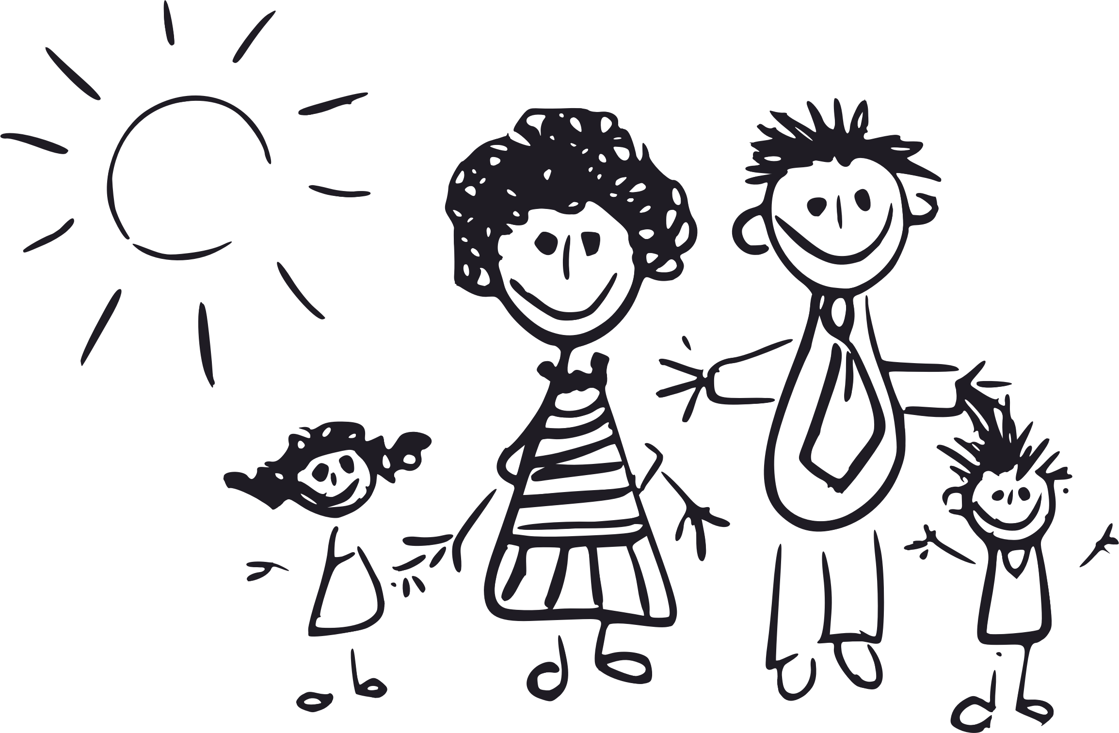
Muito Obrigado!

Slide 147
Dúvidas: tudo aquilo que se quer perguntar mas não se sabe a quem! 😊

